Slide 1
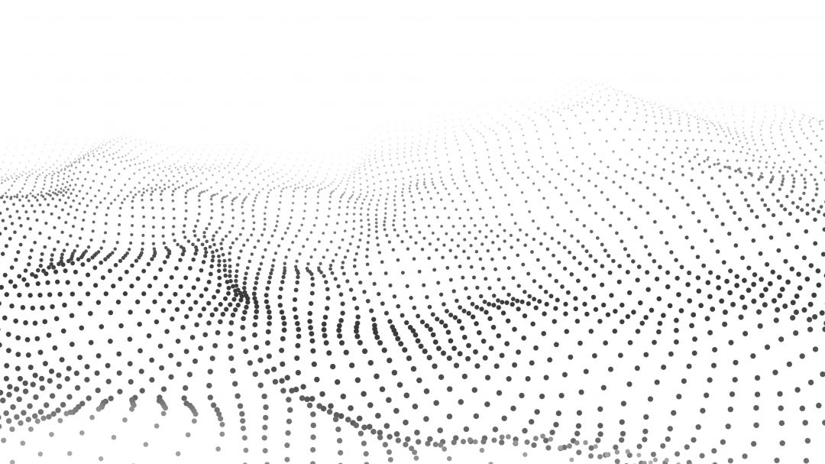

🗂️3D Sensor Data Processing Curriculum
No. | Title | Content | Date | Speaker
01 | 3D Point Cloud | 3D Point Clouds Point Cloud Processing | 08.13 | 이용이 (SOSLAB)
02 | 3D Data Acquisition (Passive) | Stereo Vision Photogrammetry & Multiview Geometry | 08.20 | 박준휘 (MagicLeap)
03 | 3D Data Acquisition (Active) | RGB-D Camera LiDAR Projector-Camera System | 08.27 | 함승록 (LG전자)
04 | Differential Geometry | Differential Geometry | 09.03 | 장승호 (MORAI)
05 | Spatial Transformation | Spatial Transformation | 09.03 | 이용이 (SOSLAB)
06 | Point Cloud Analysis #1 | Filtering Nearest Neighbor Search | 09.10 | 길현재 (서울대학교)
07 | Point Cloud Analysis #2 | Model Fitting Point Cloud Features | 09.10 | 윤형석 (CMES)
08 | Point Cloud Analysis #3 | Classification and Segmentation Registration | 09.17 | 최재우 (PLAIF)
09 | Point Cloud Analysis #4 | Clustering | 09.17 | 신동훈 (SOSLAB)
10 | Point Cloud Analysis #5 | Deep Learning on Point-cloud | 09.24 | 이종록 (VUERON Technology)
11 | Point Cloud Analysis #6 | Communication Visualization | 09.24 | 이상운 (Seoul Robotics)
12 | PCD Tools | PCL Open3D CloudCompare | 10.08 | 최준호 (SOSLAB)

Slide 2
3D Sensor Data Processing (2023)
Spatial Transformation
2023. 09. 03
이 용 이 (yongyi.lee@soslab.co)

Slide 3
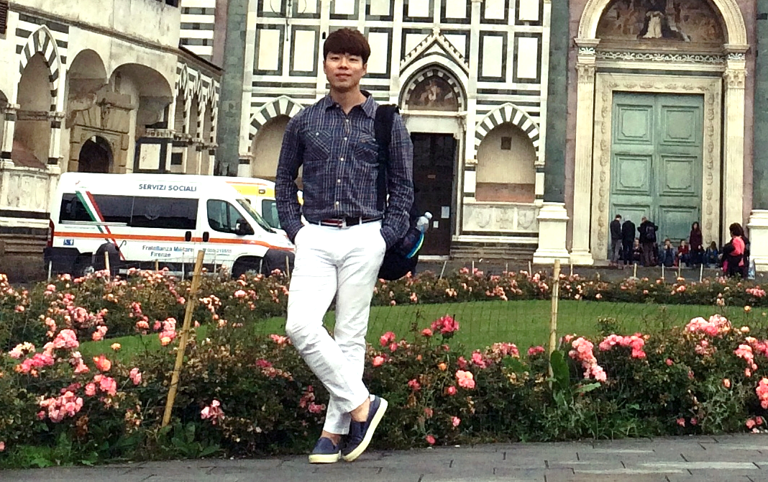
About Me
Education
GIST (Gwangju Institute of Science and Technology) Ph.D. degree in School of Mechanical Engineering Mar 2014 – Feb 2019
GIST (Gwangju Institute of Science and Technology) M.S. degree in School of Mechatronics Mar 2012 – Feb 2014
CBNU (Chungbuk National University) B.S. degree in Electronics Engineering Mar 2005 – Feb 2012
이 용 이 (Yongyi Lee)
Head of Data & Solution Dev. / SOS LAB
Head of Data & Solution Dev., Dec 2022 – Current
S/W Team Leader of Solid-state LiDAR Dev. Sep 2021 – Nov 2022
Perception S/W Team Leader of Product Dev. Jan 2021 – Aug 2021
LiDAR App. S/W Team Leader of Advanced Research Div. Dec 2018 – Dec 2020
Research Interest
Computer Graphics (Point-Cloud Data Processing) Computer Vision (Depth Camera, 3D LiDAR) Machine Learning (2D/3D Perception) Virtual/Augmented Reality (Projector-Camera, Spatial AR) Human Computer Interaction (Shape Change Display)

Slide 4
Overview
Spatial Transformation
Spatial Transformation
Linear Map
Rotations
Reflections
Scaling
Shear
Translations
Composition of Transformations
Homogeneous Coordinates
Homogeneous Coordinates (2D)
Translation in Homogeneous Coordinates
3D Transformations in Homogeneous Coordinates

Slide 5
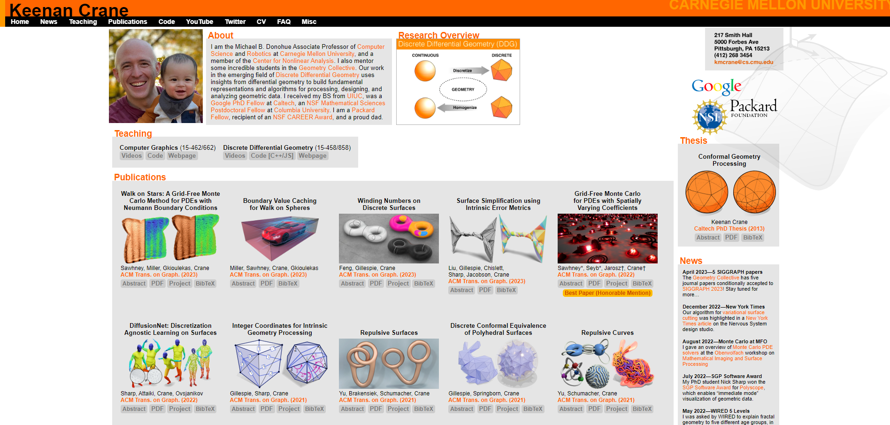
3D Sensor Data Processing (2023)
⚠️ All the materials have been sourced from the following lecture.
Computer Graphics / CMU 15-462/15-662
(https://www.cs.cmu.edu/~kmcrane/)
Prof. Keenan Crane

Slide 6
3D Sensor Data Processing (2023)
Spatial Transformation

Slide 7
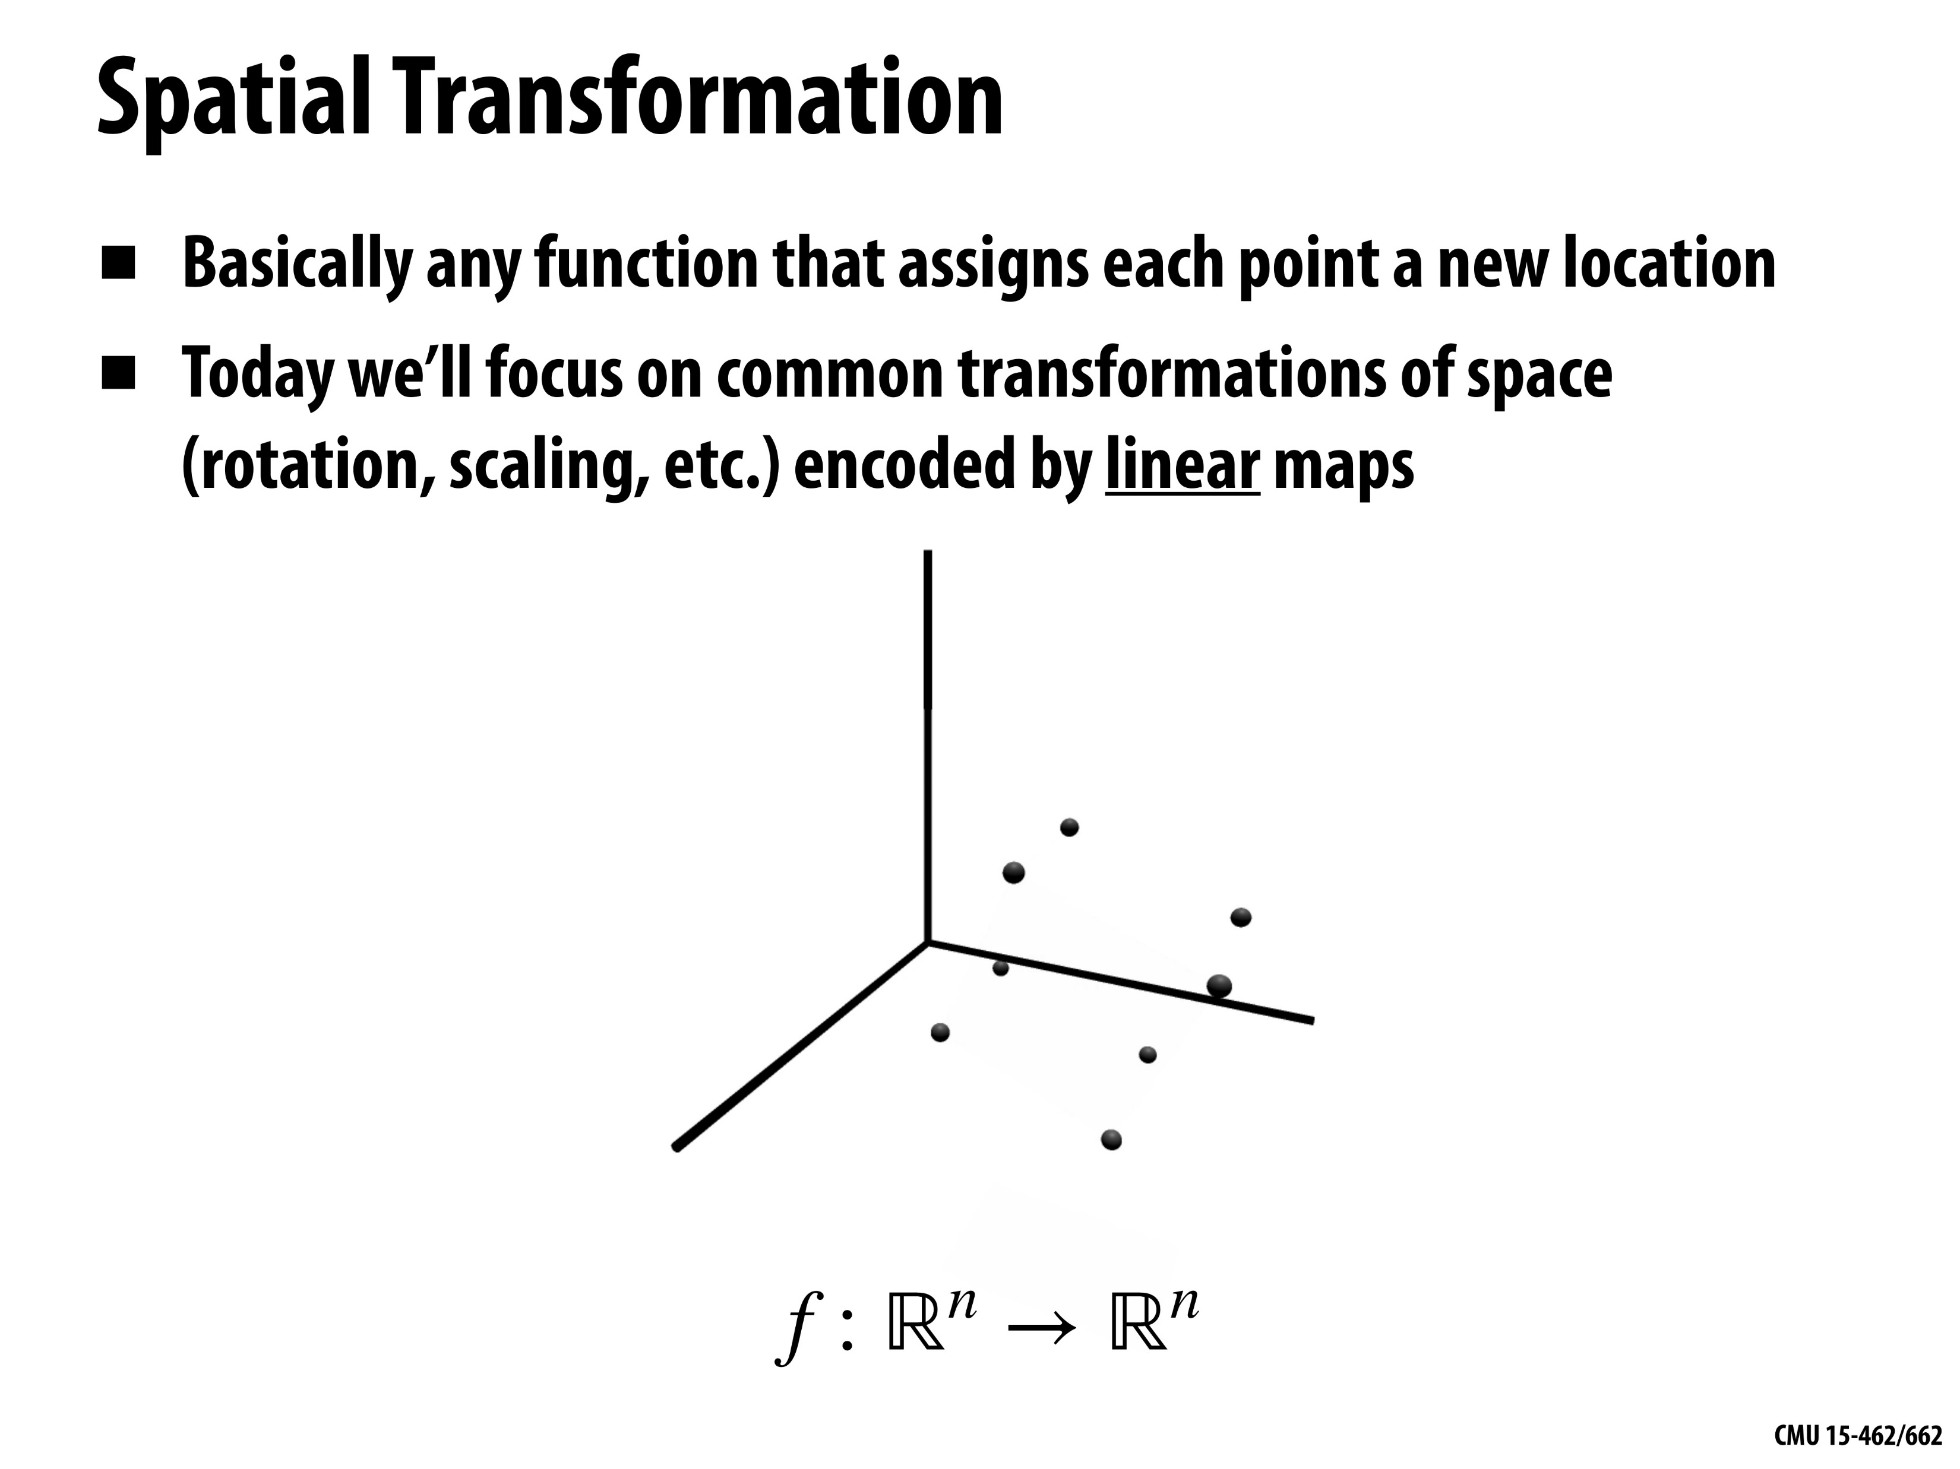
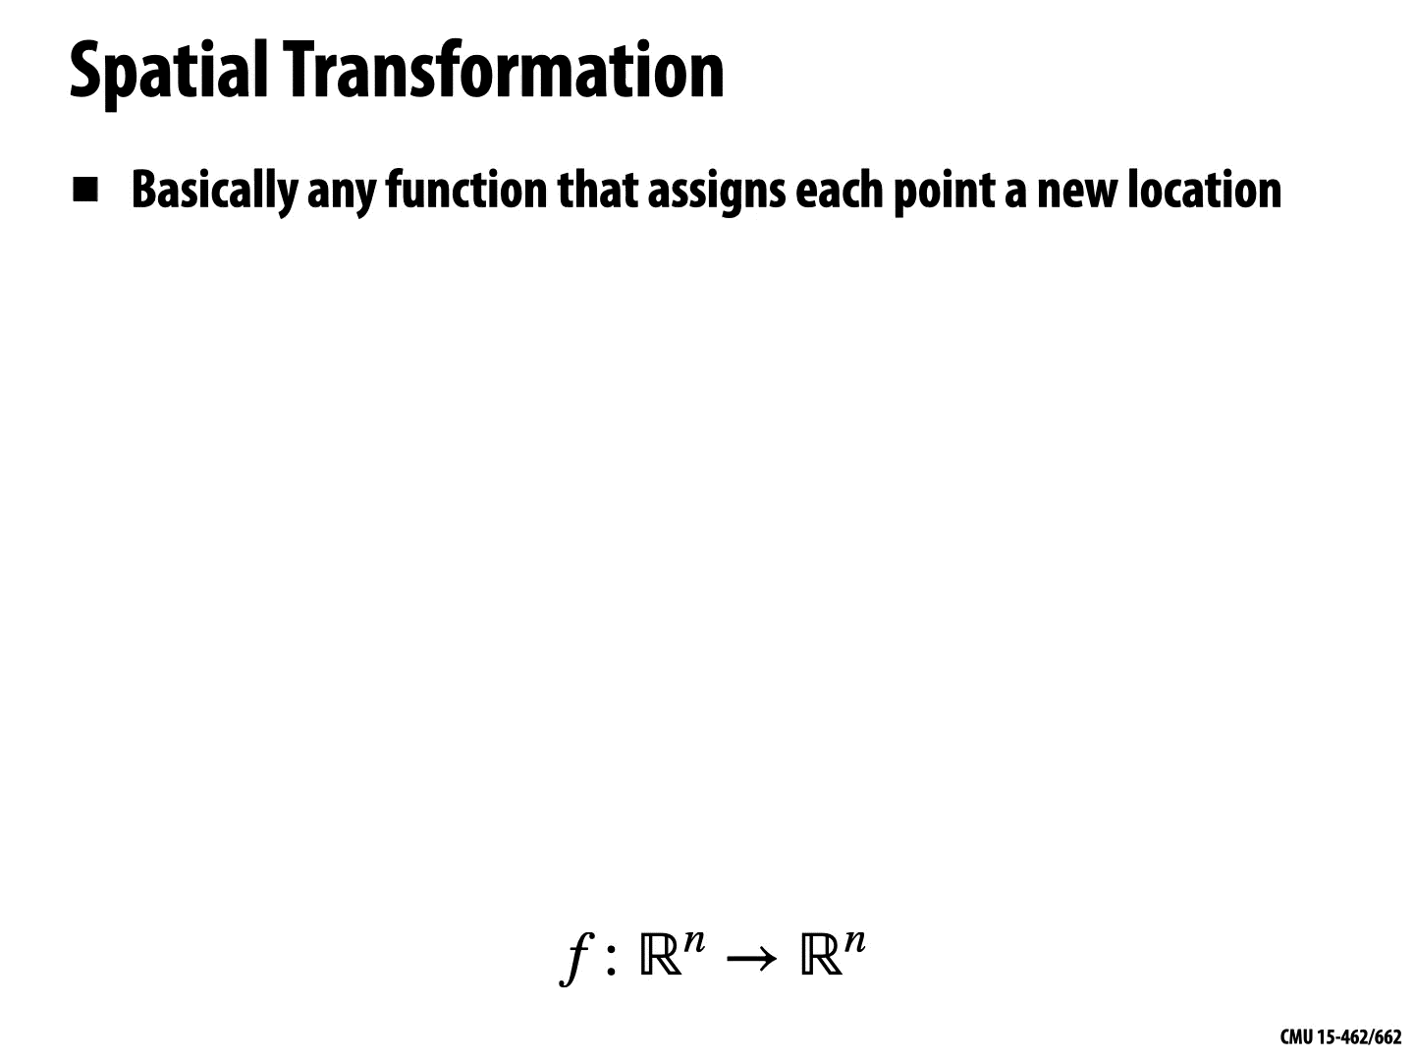
© Keenan Crane

Slide 8
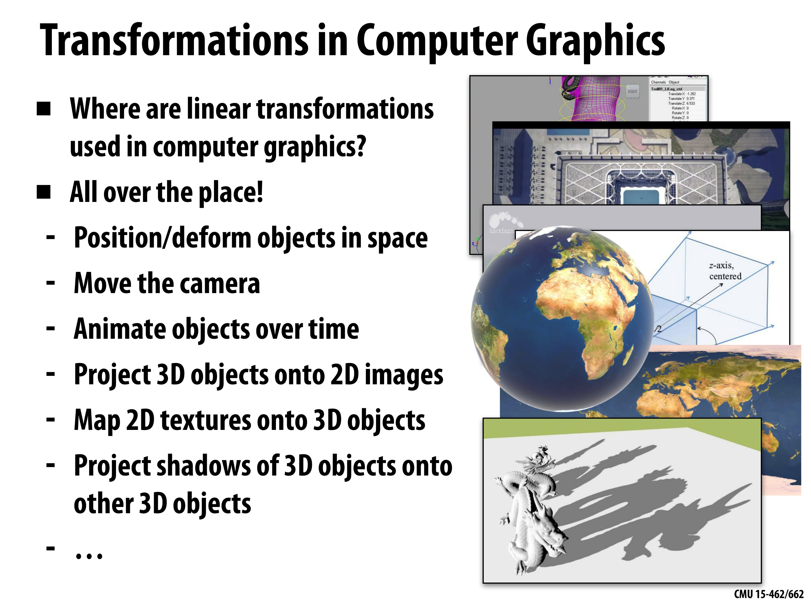
© Keenan Crane

Slide 9
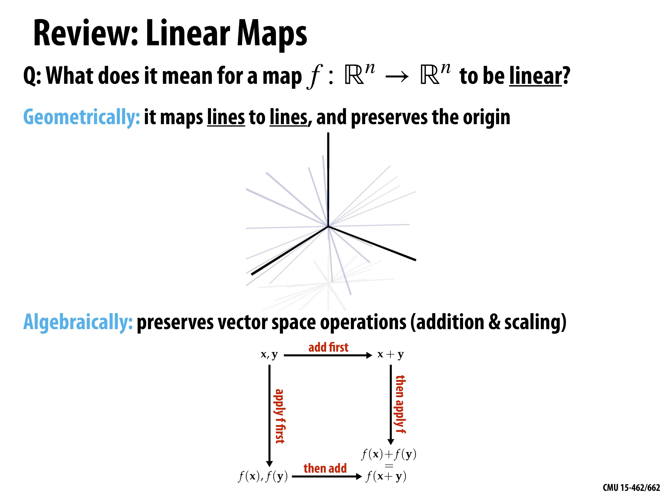
© Keenan Crane

Slide 10
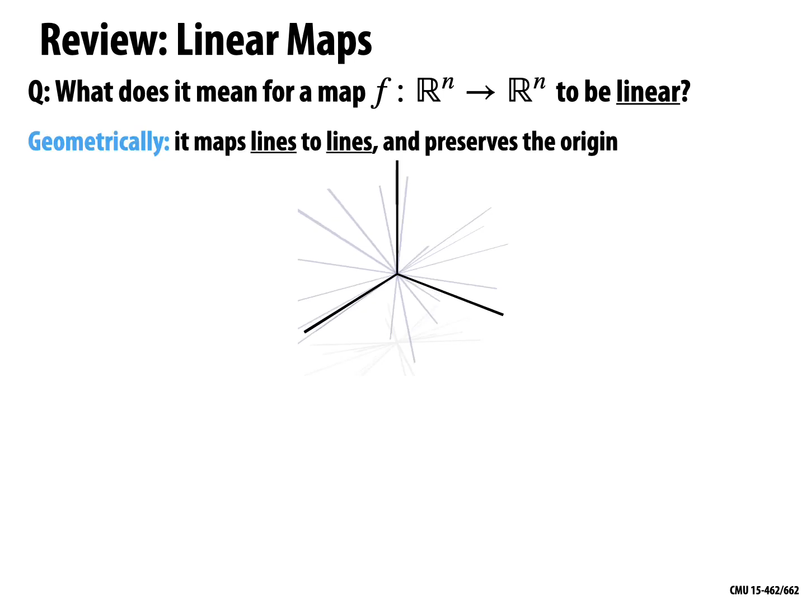
© Keenan Crane

Slide 11
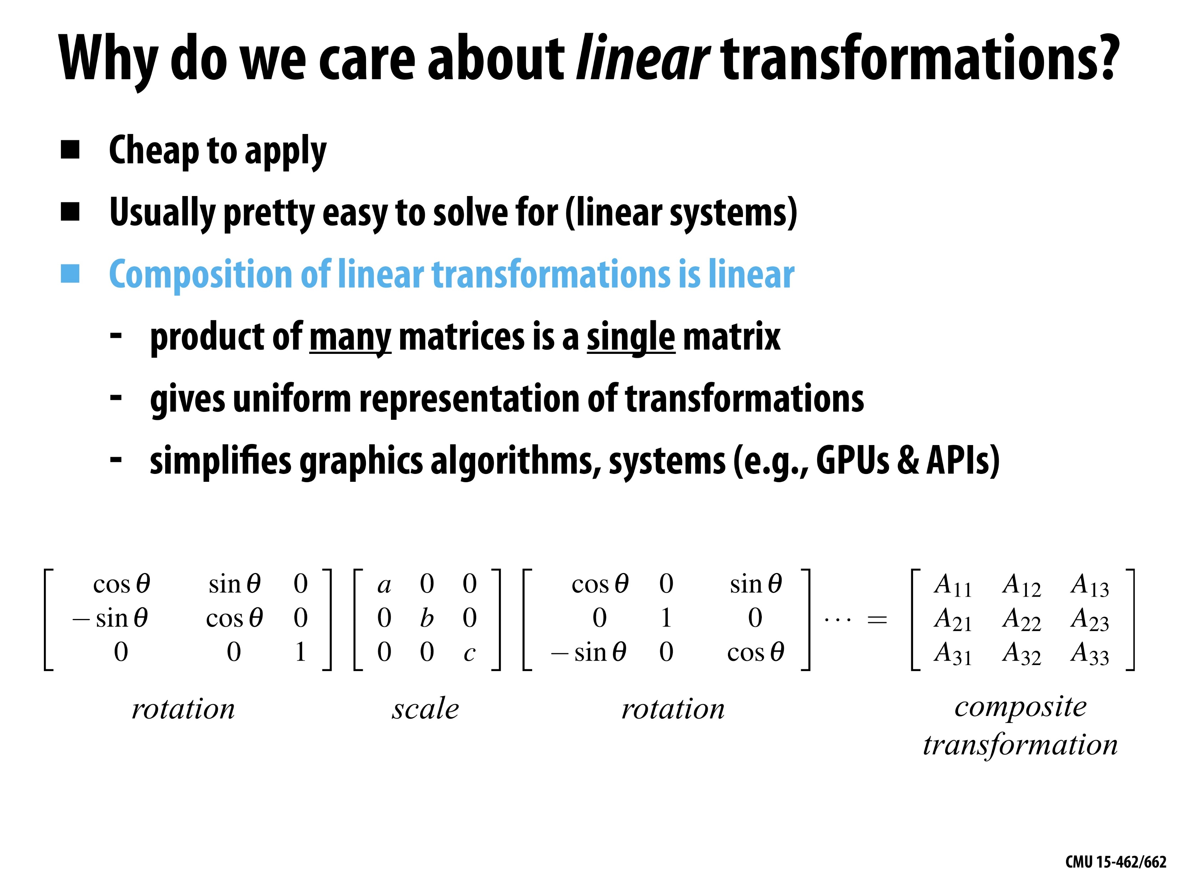
© Keenan Crane

Slide 12
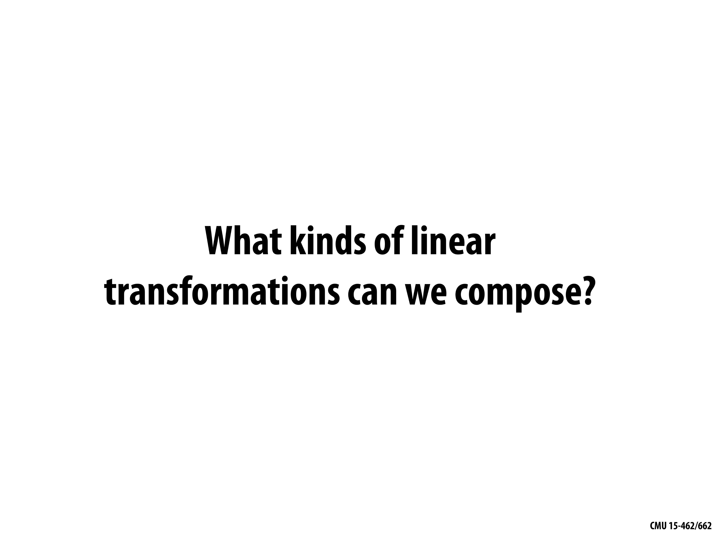
© Keenan Crane

Slide 13
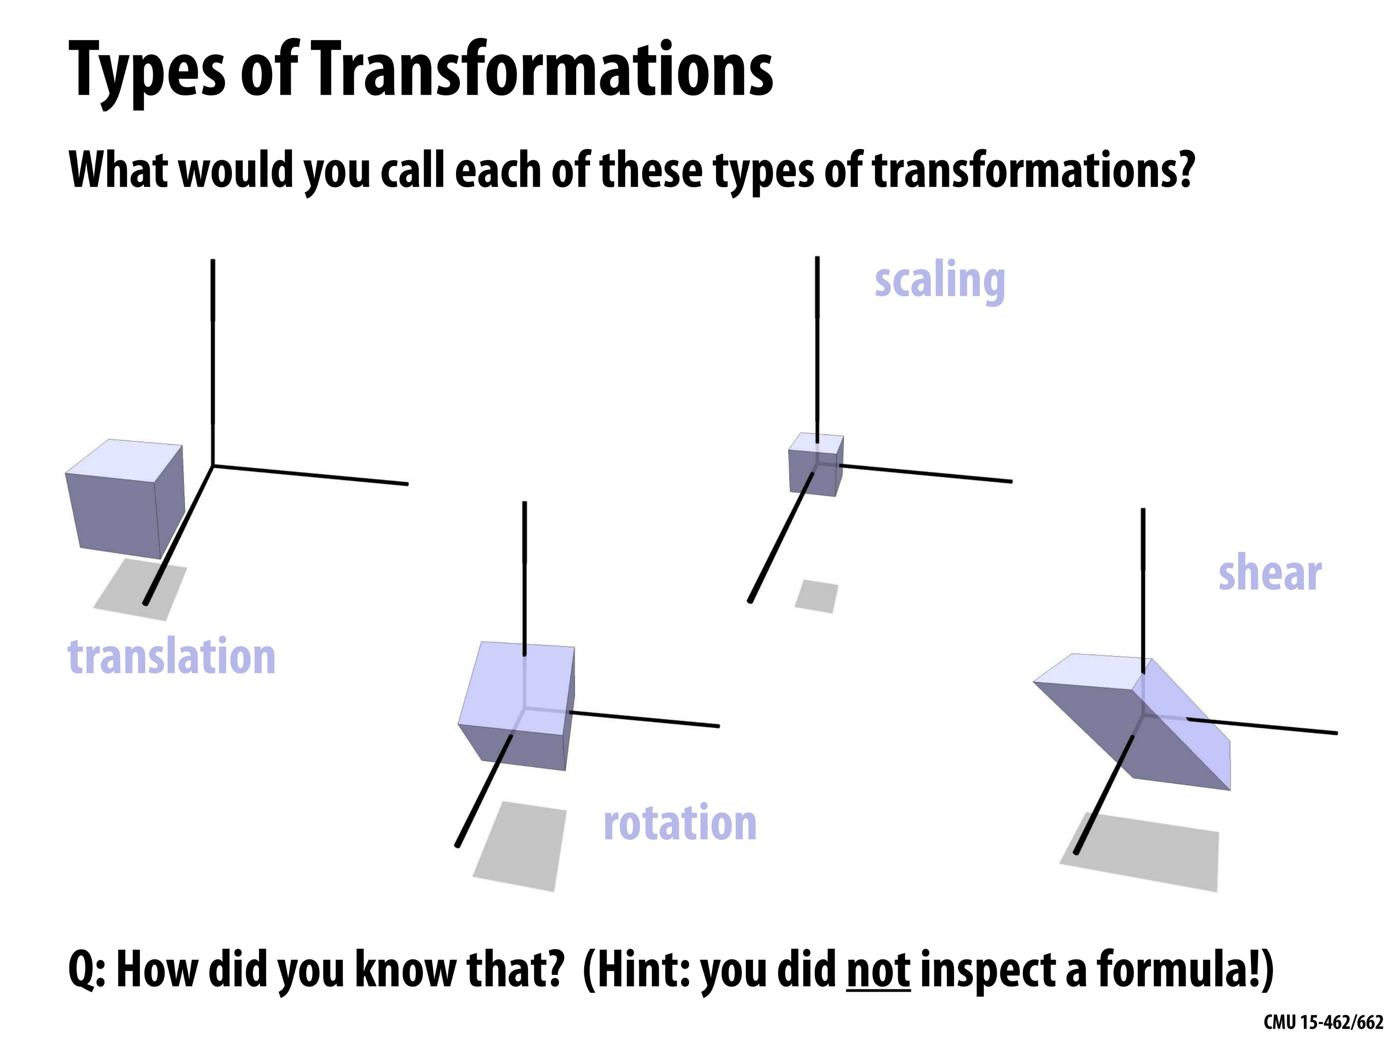
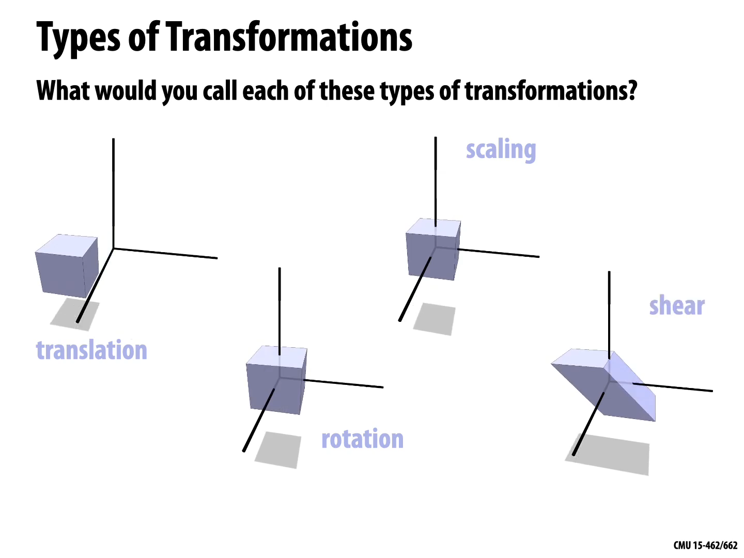
© Keenan Crane

Slide 14
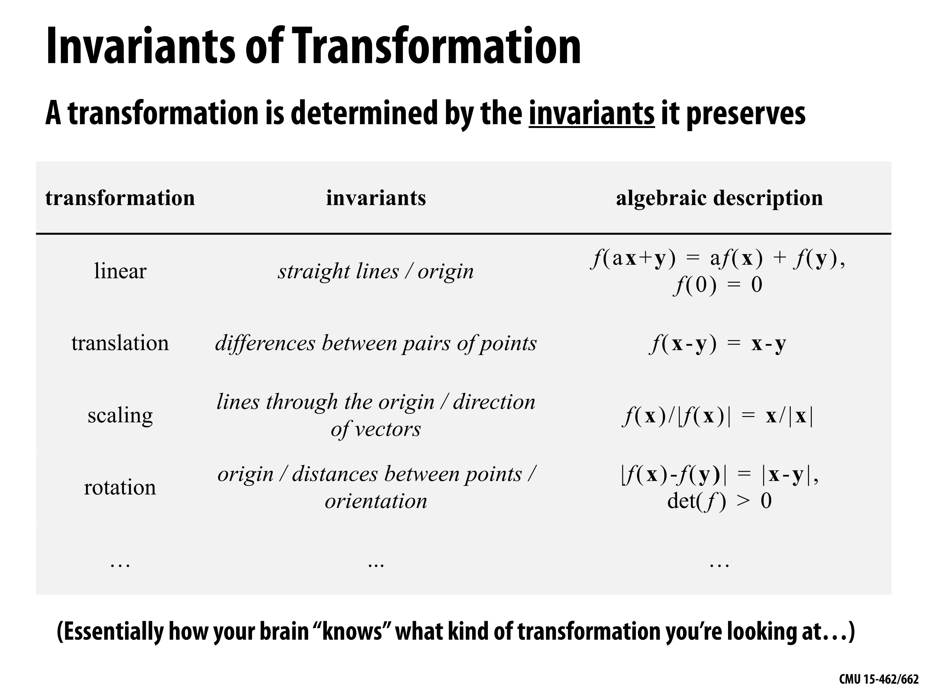
© Keenan Crane

Slide 15
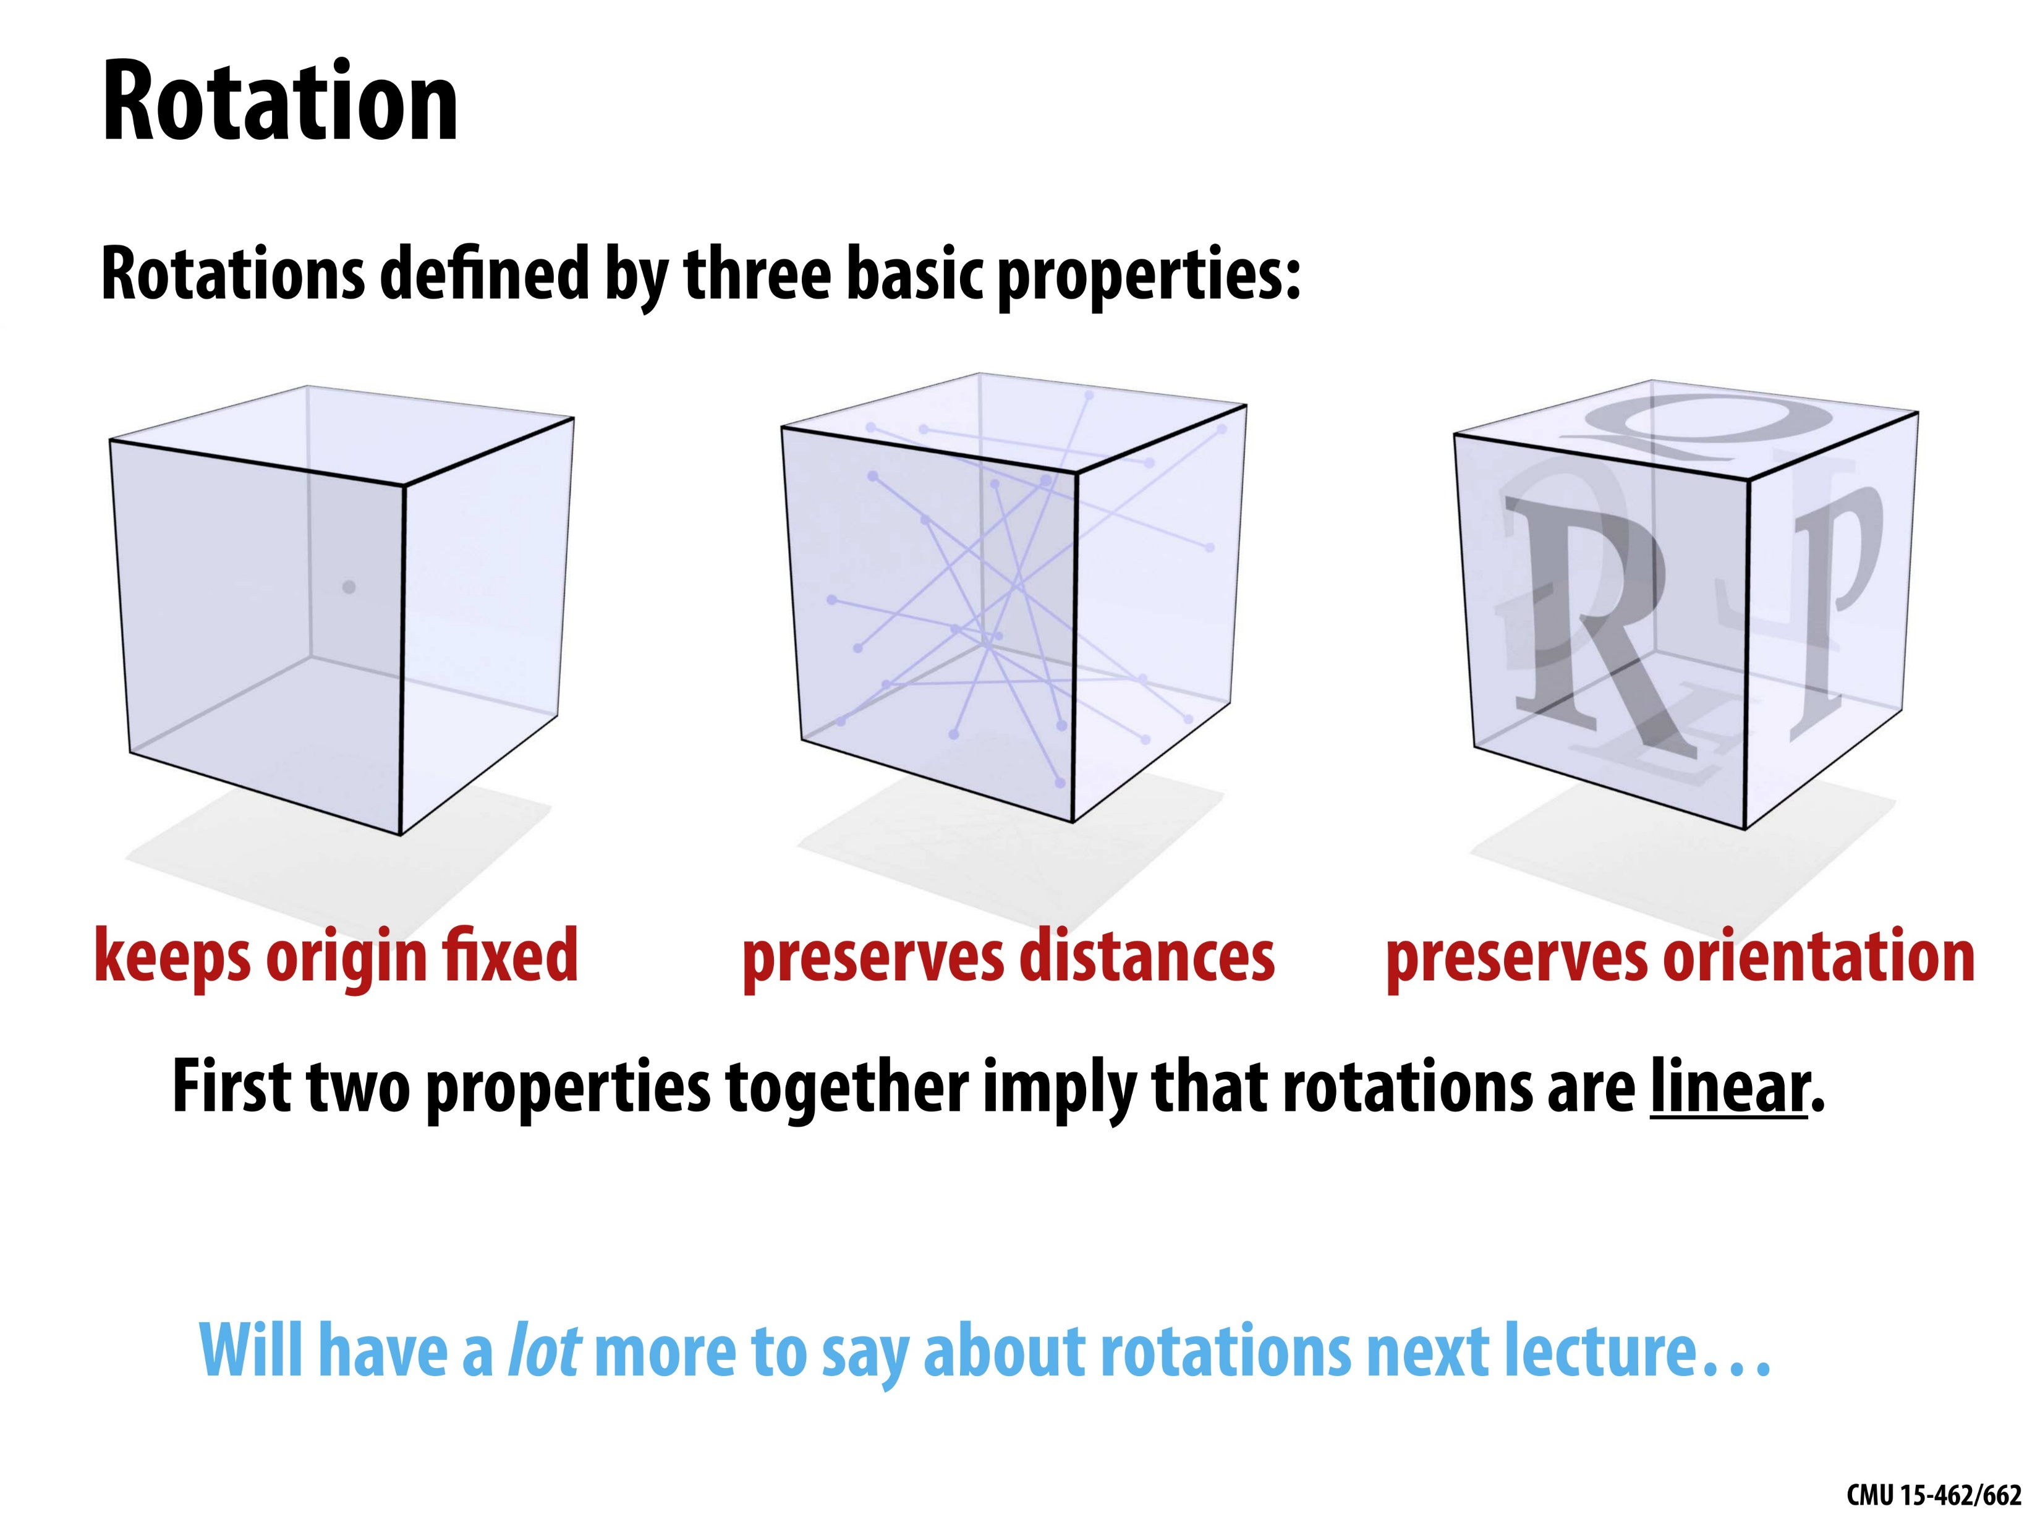
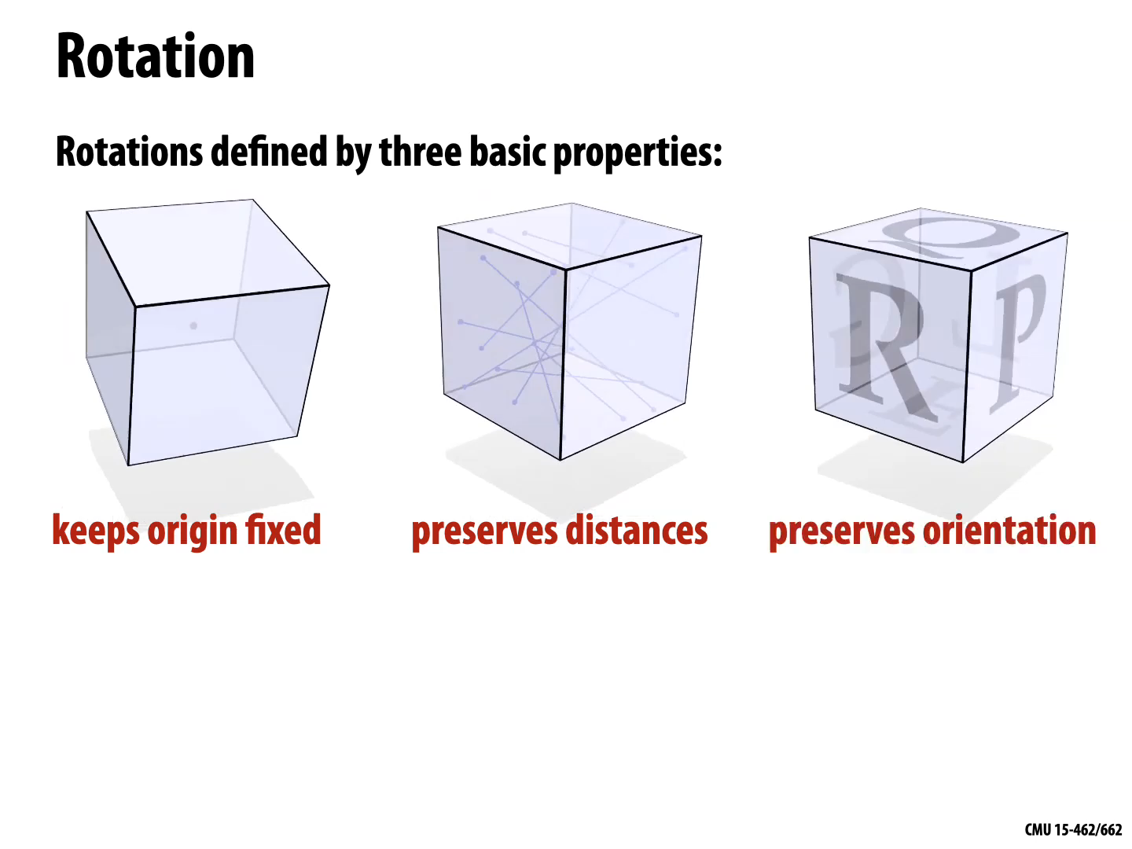
© Keenan Crane

Slide 16
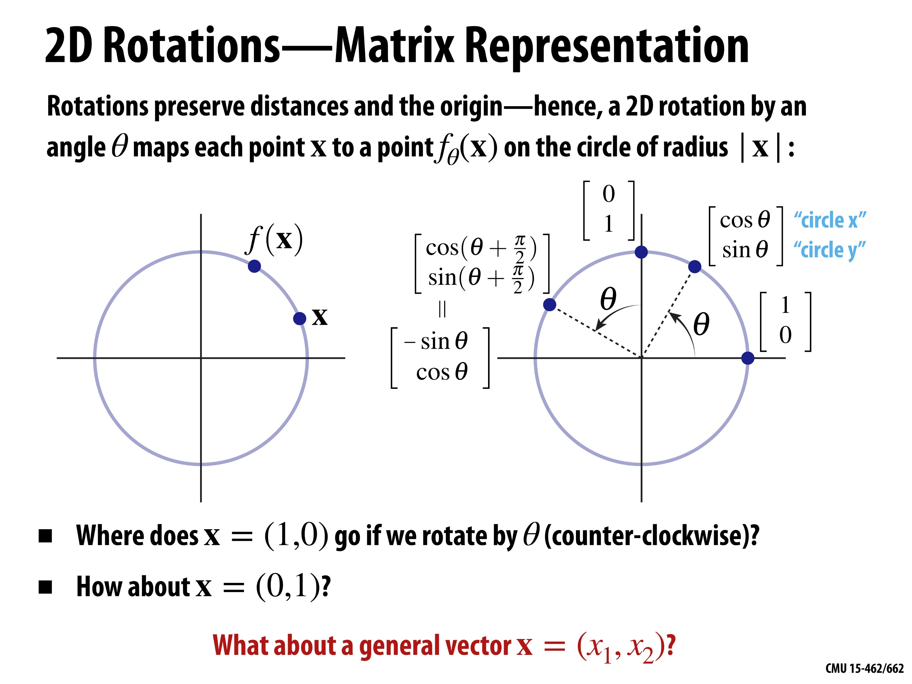
© Keenan Crane

Slide 17
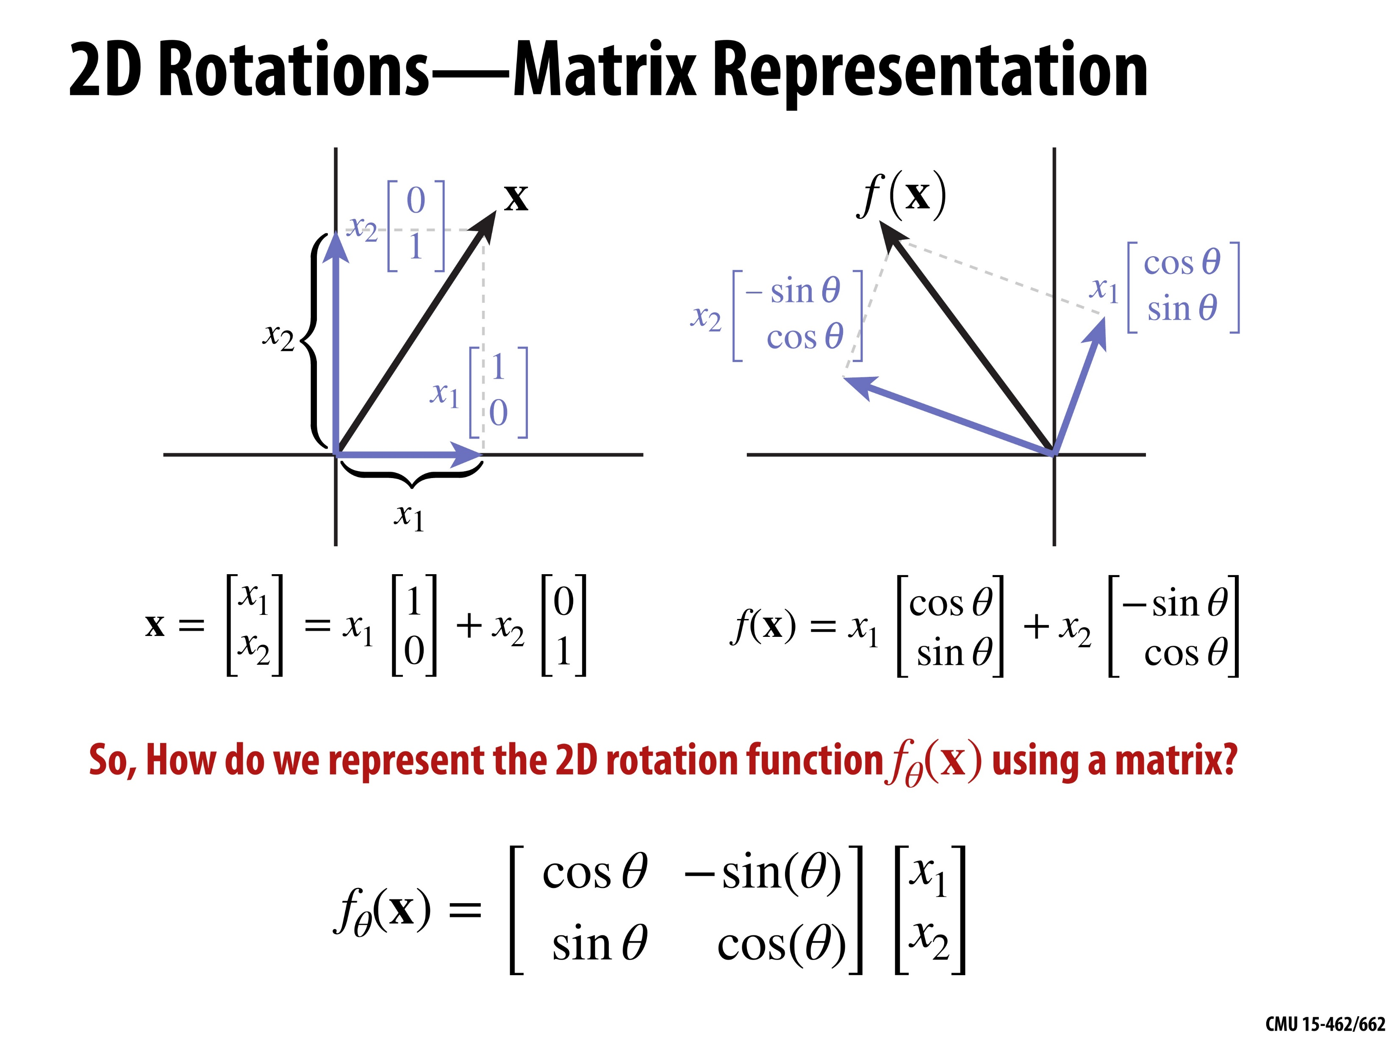
© Keenan Crane

Slide 18
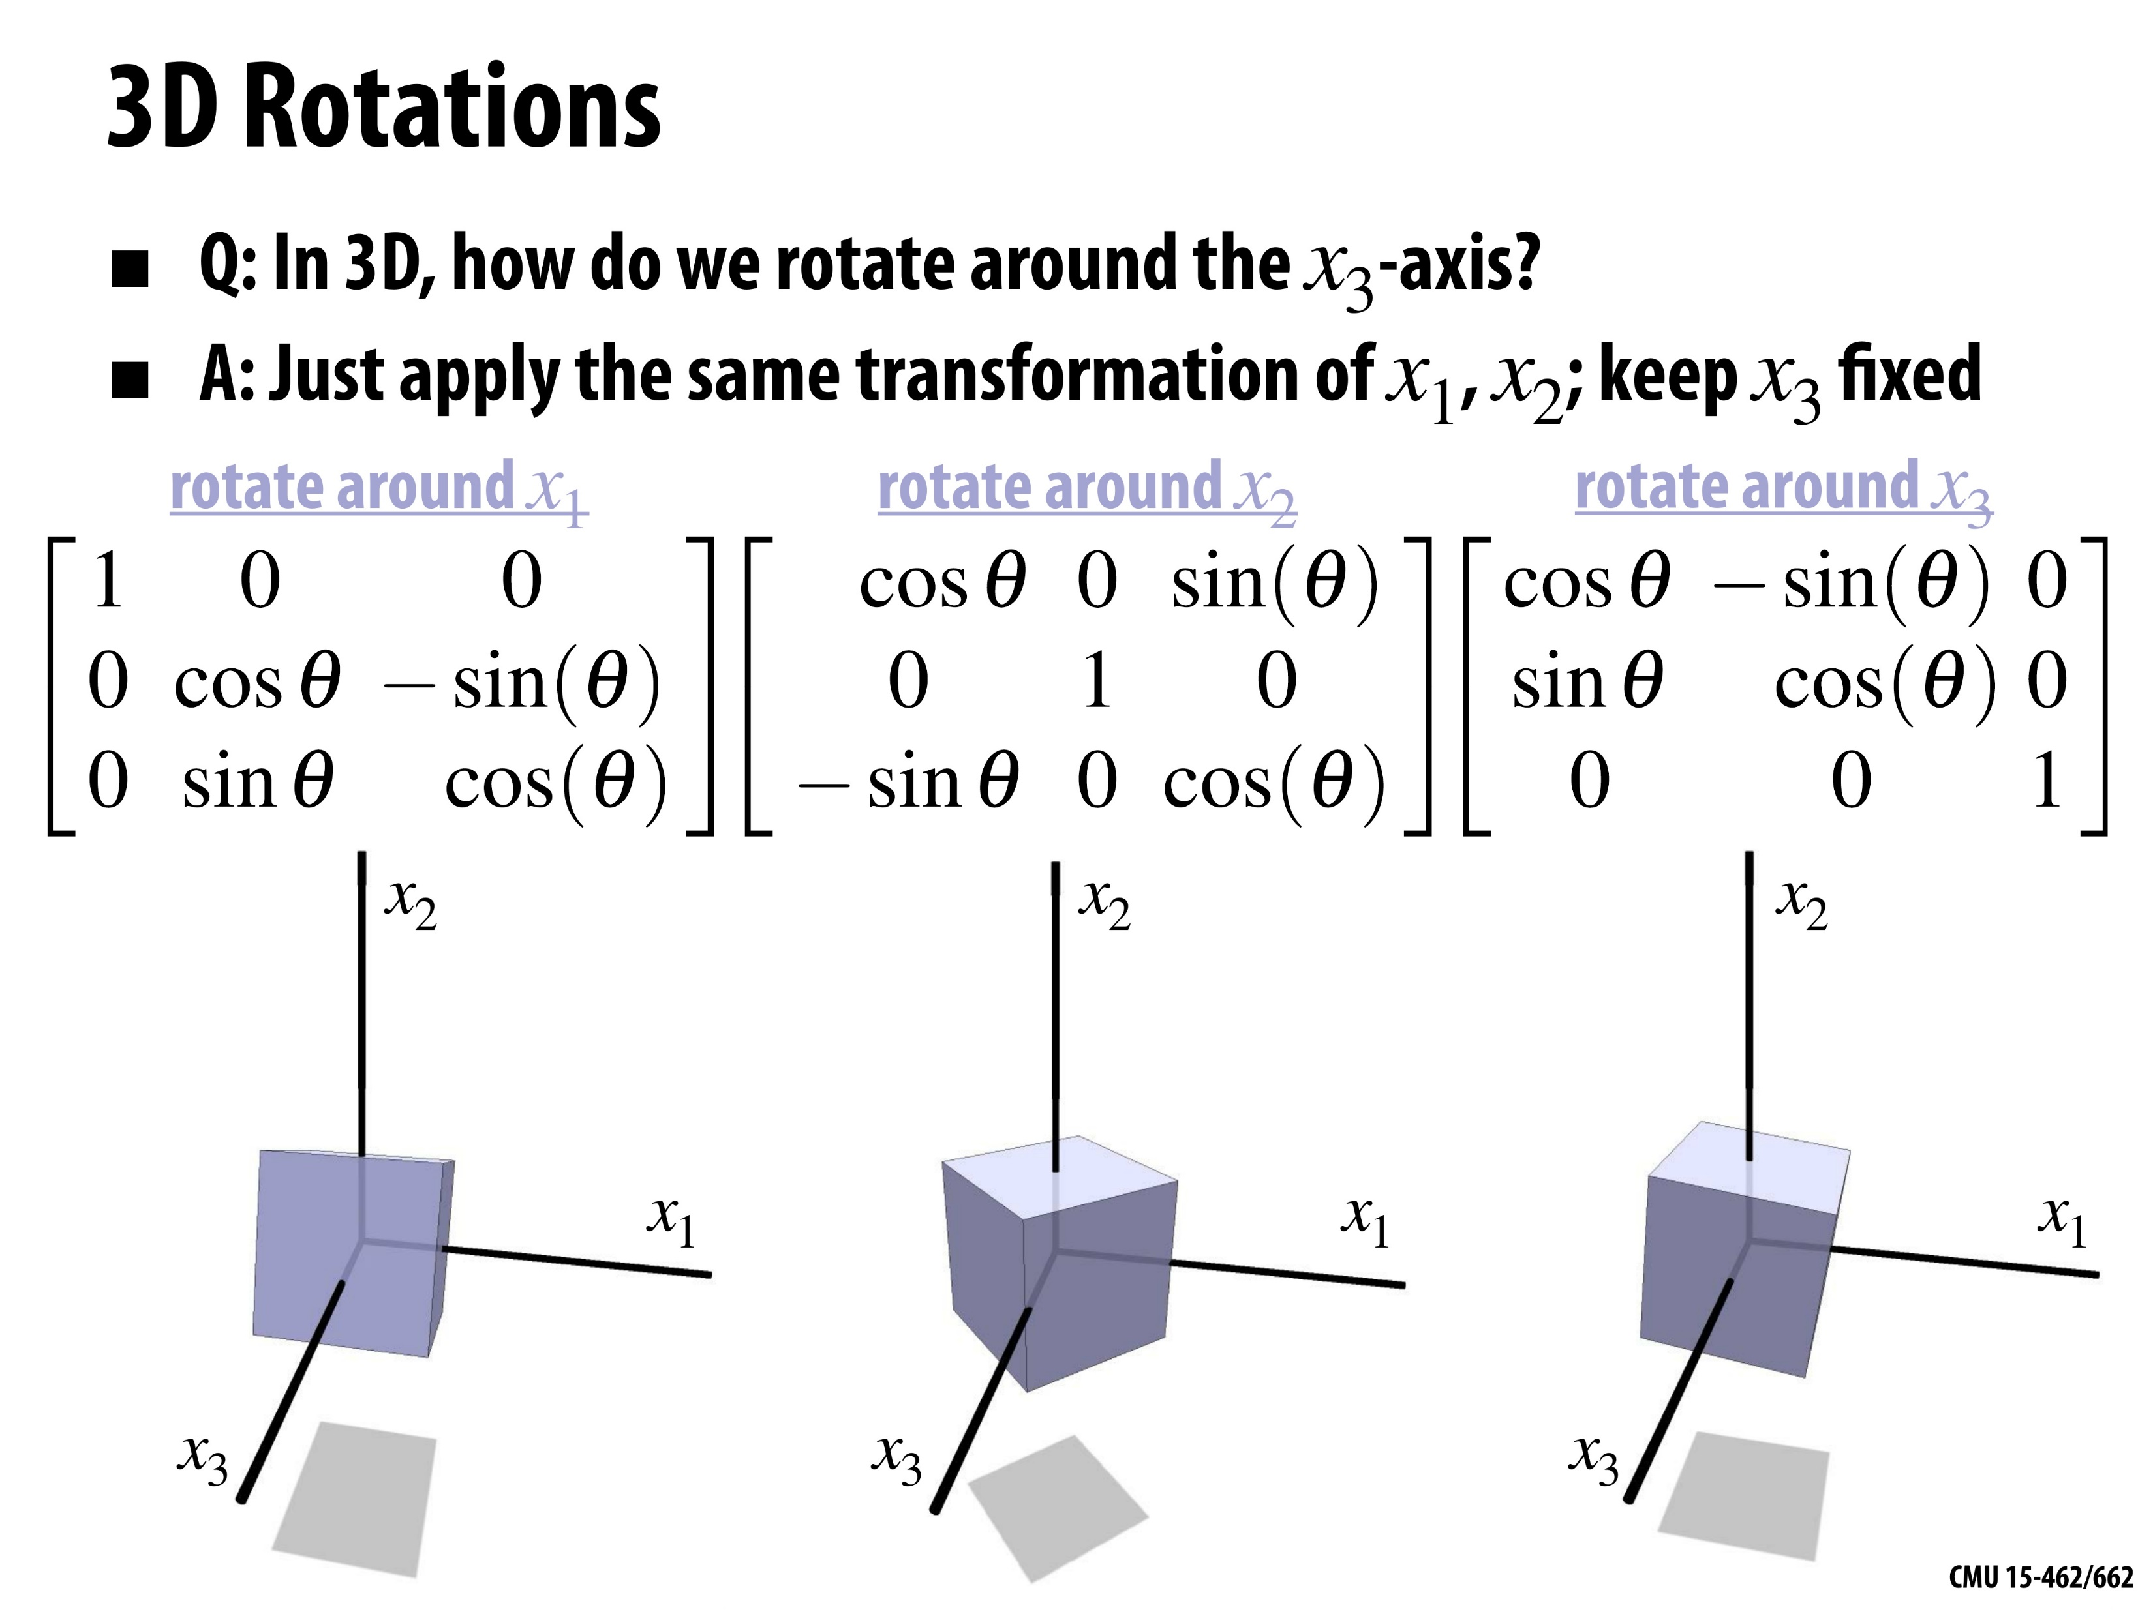
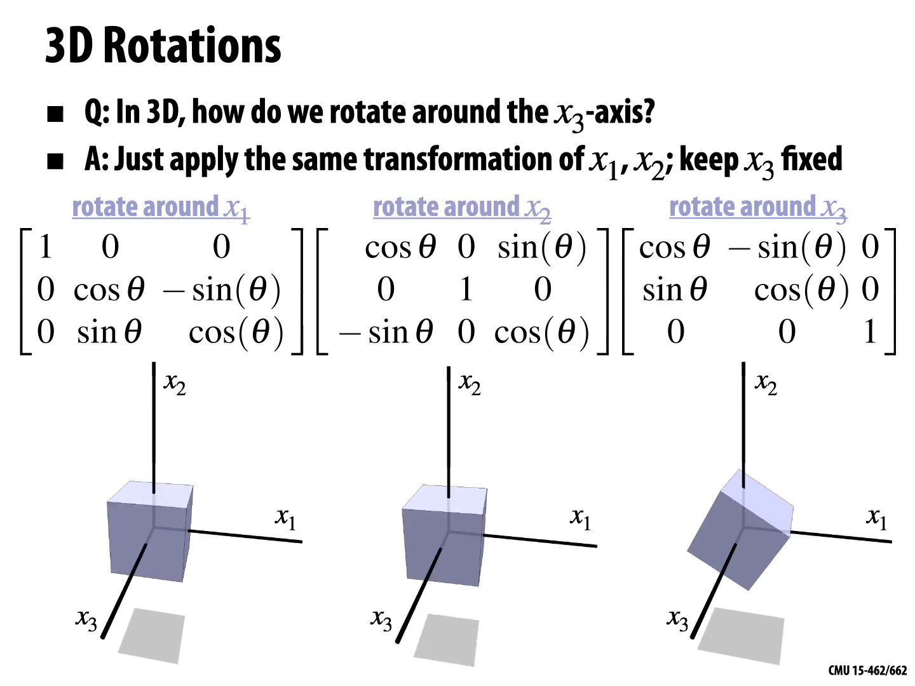
© Keenan Crane

Slide 19
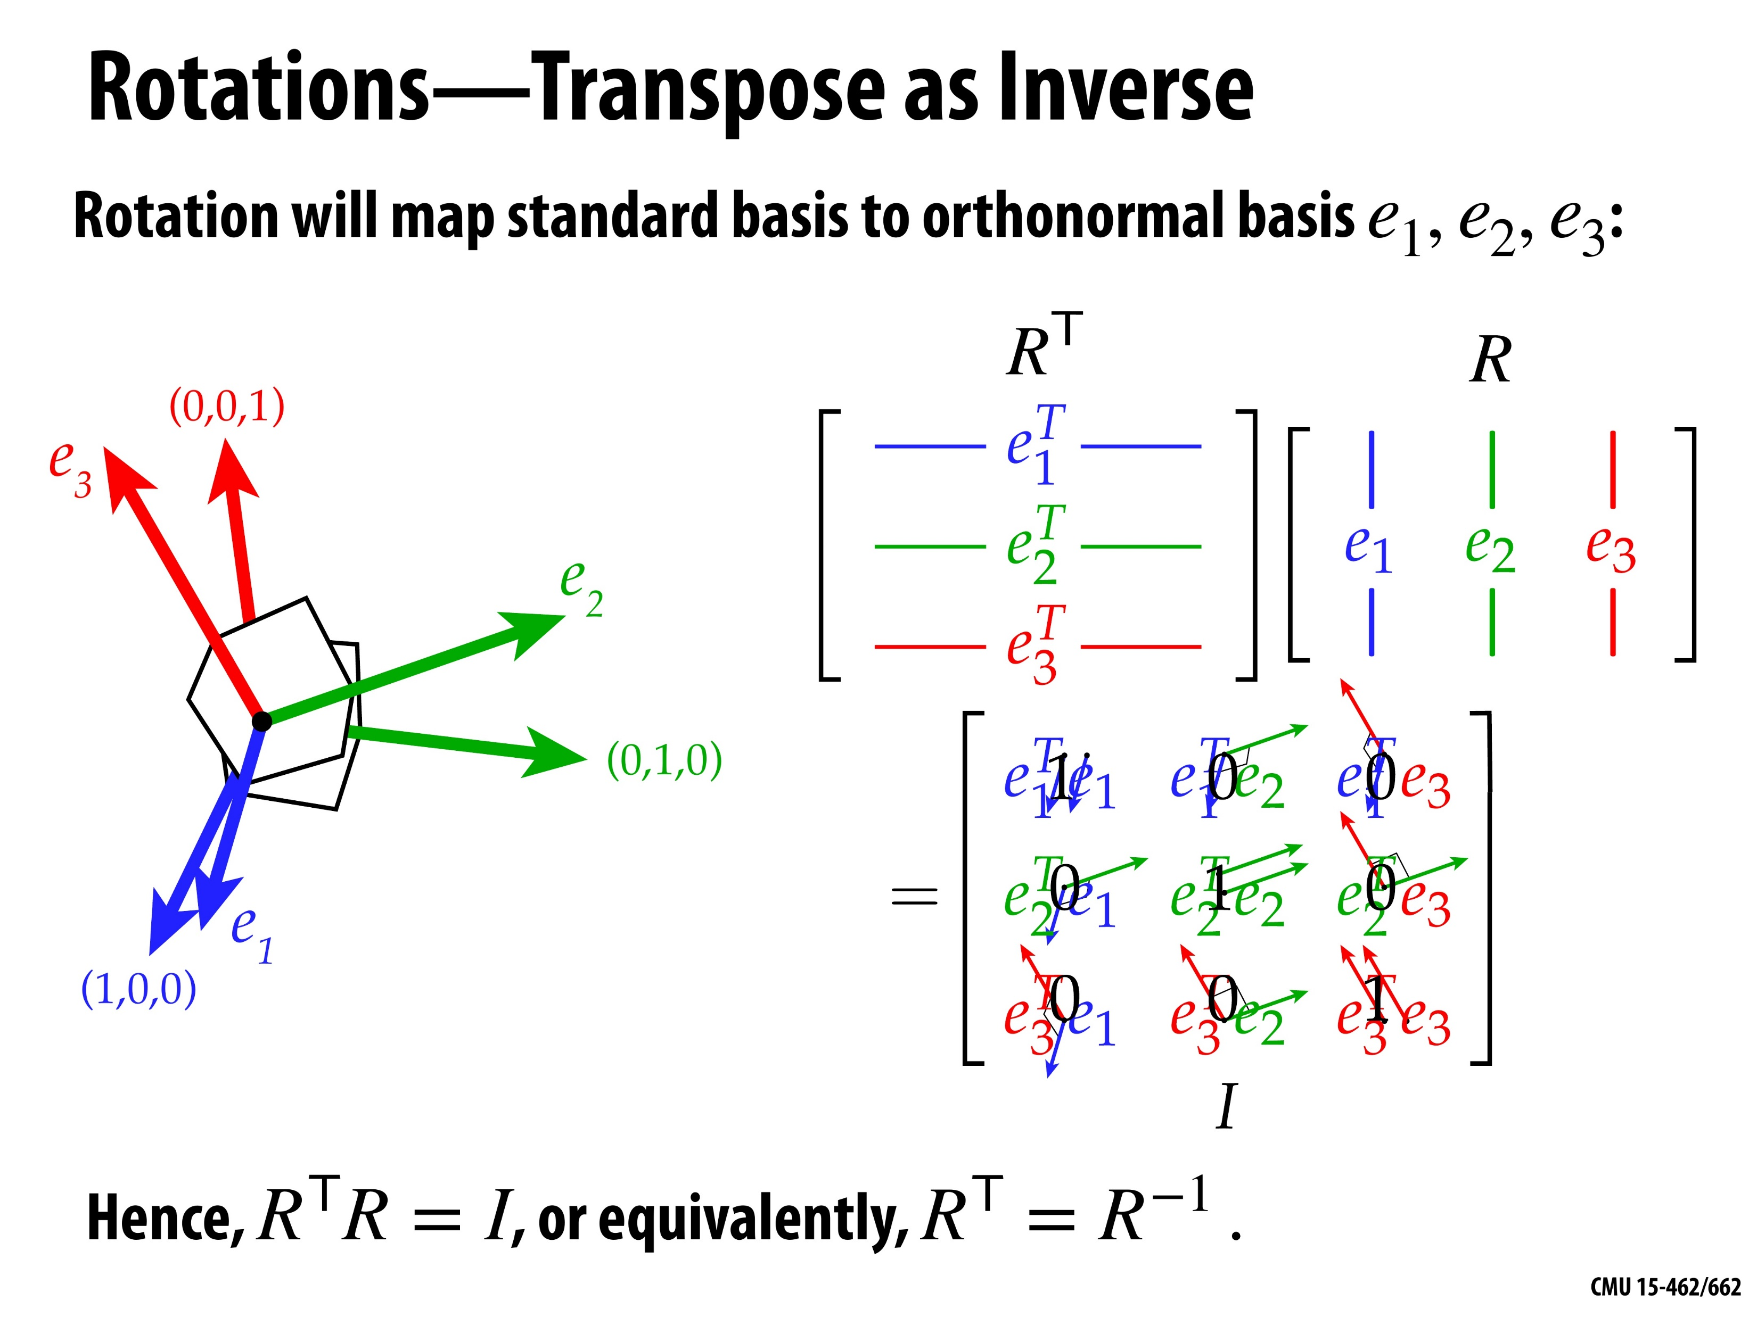
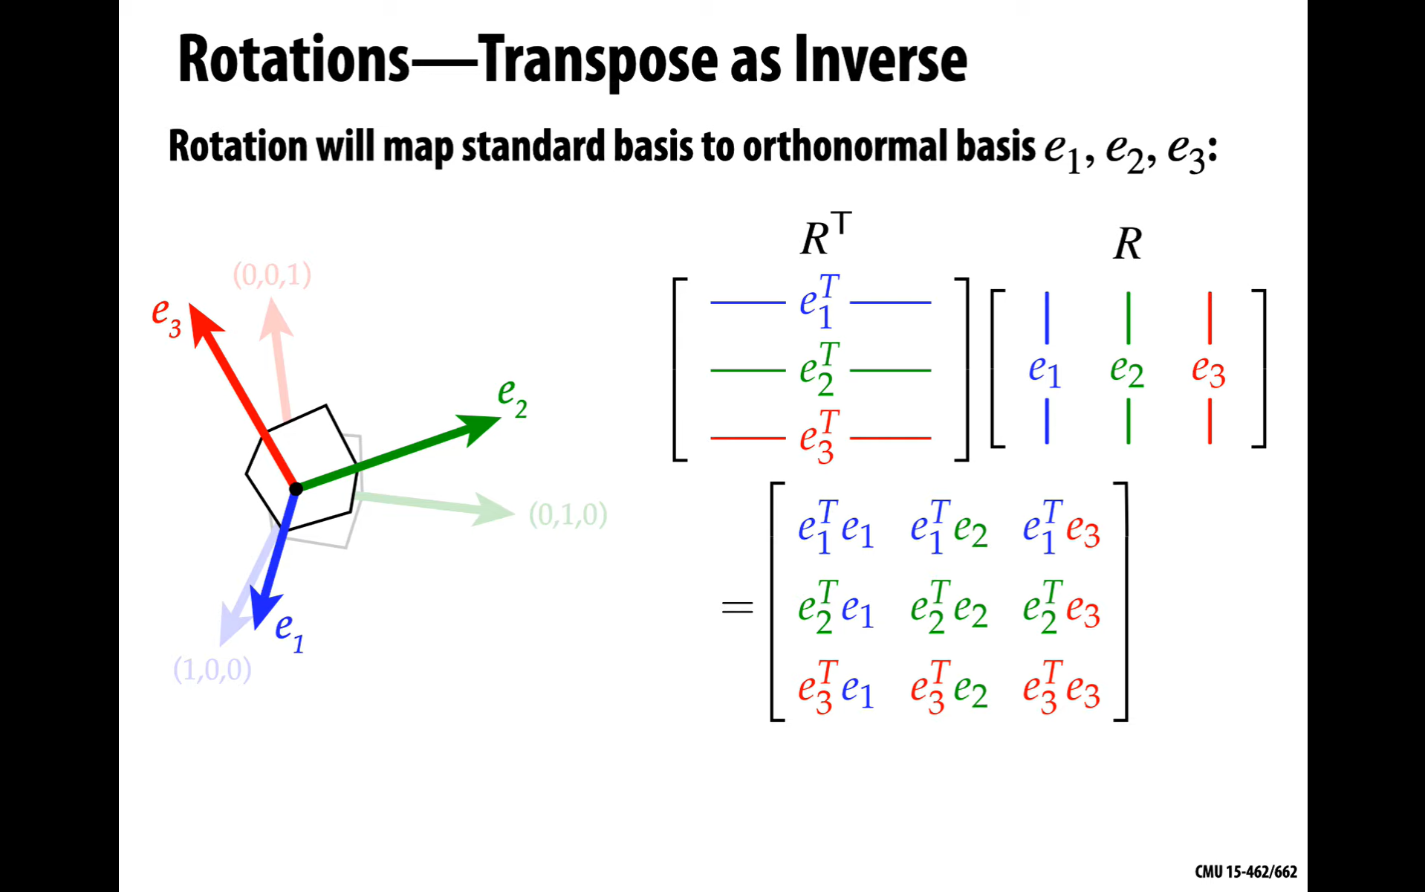
© Keenan Crane

Slide 20

© Keenan Crane

Slide 21
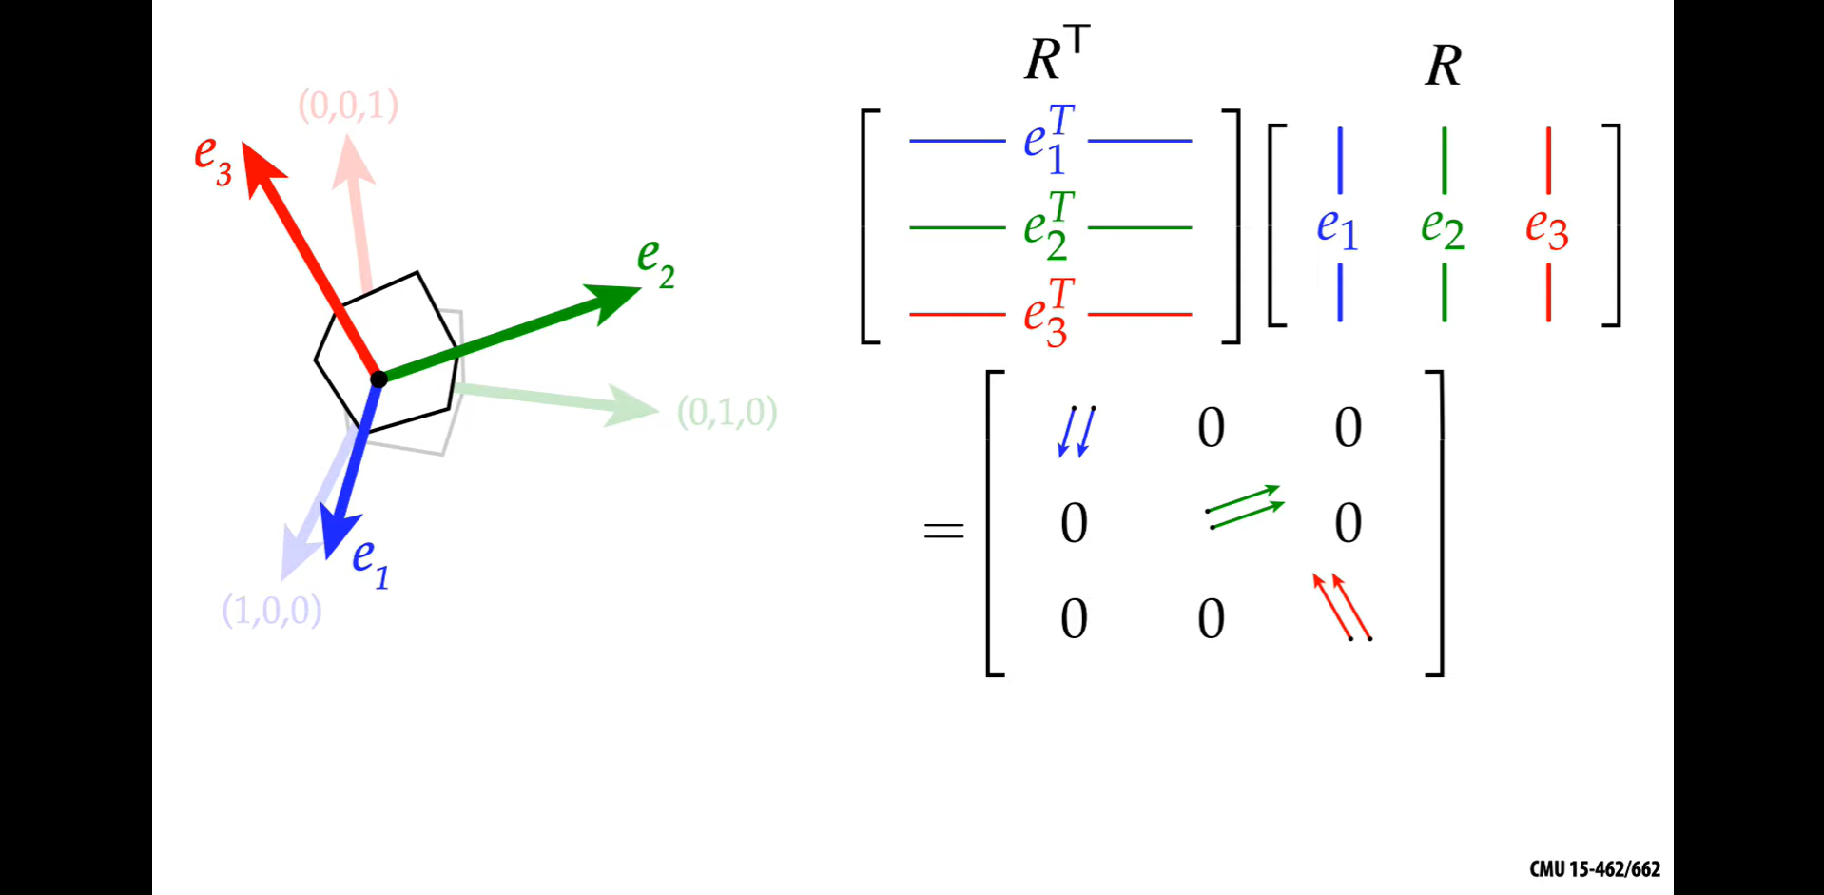
© Keenan Crane

Slide 22

© Keenan Crane

Slide 23
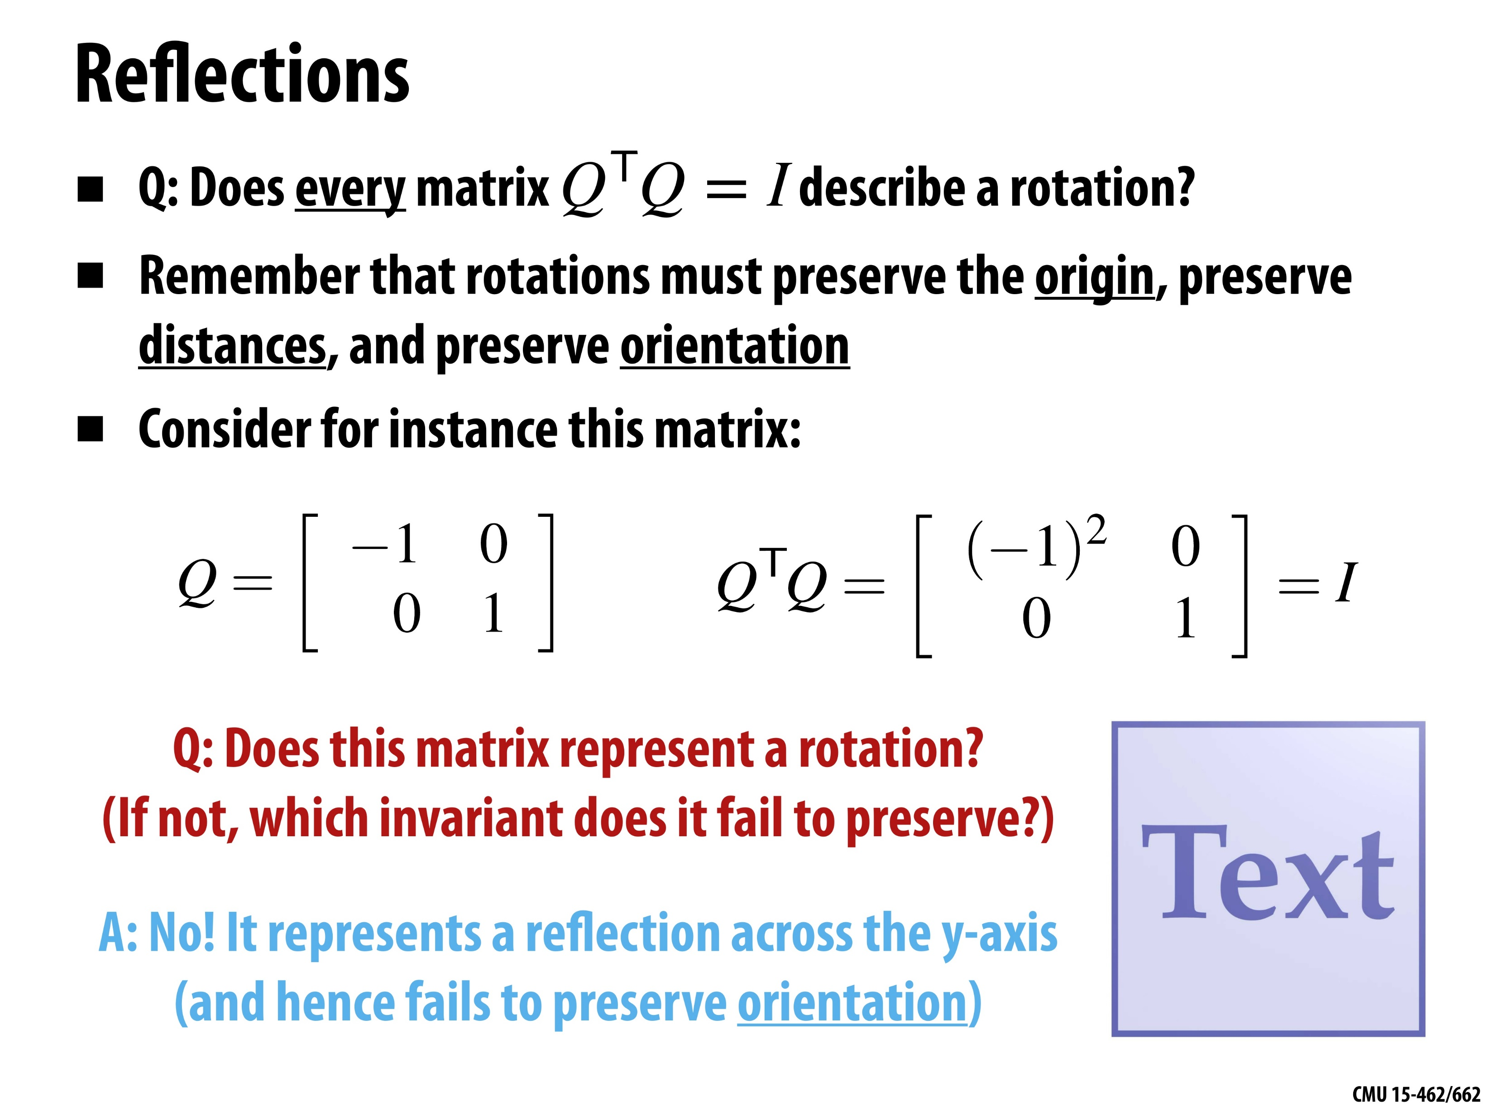
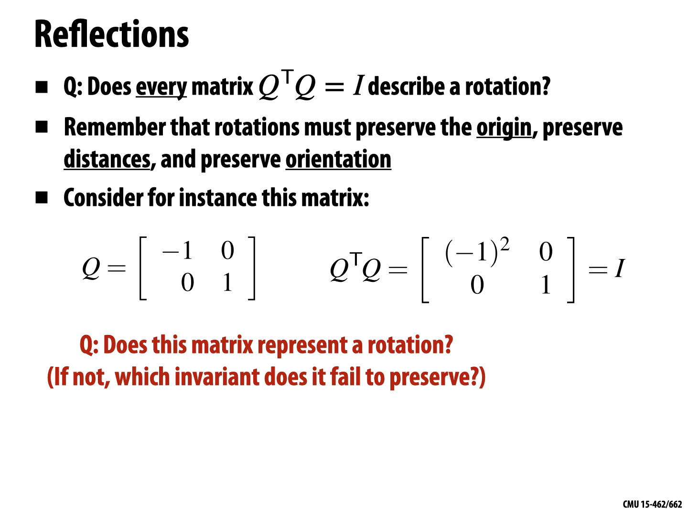
© Keenan Crane

Slide 24
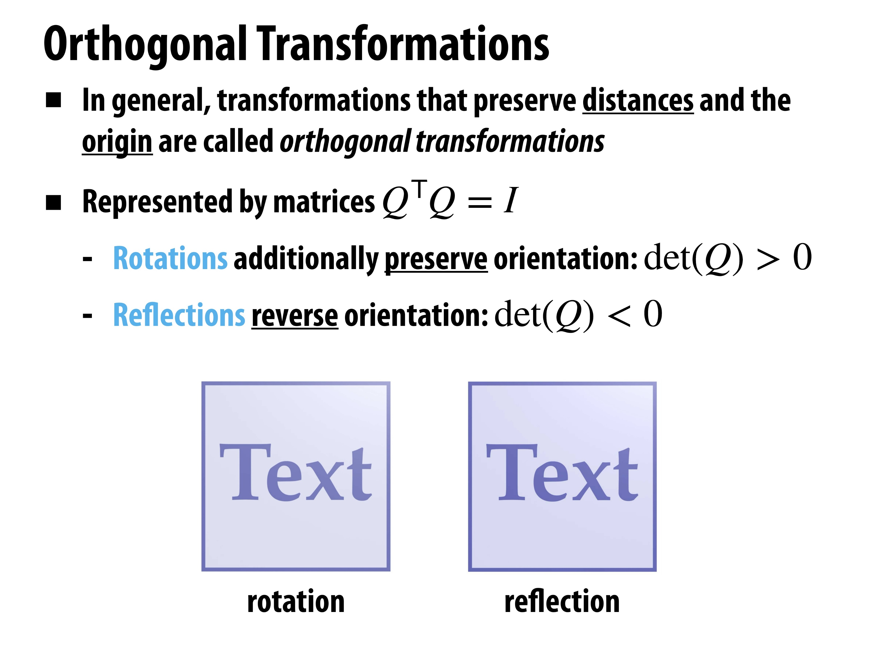
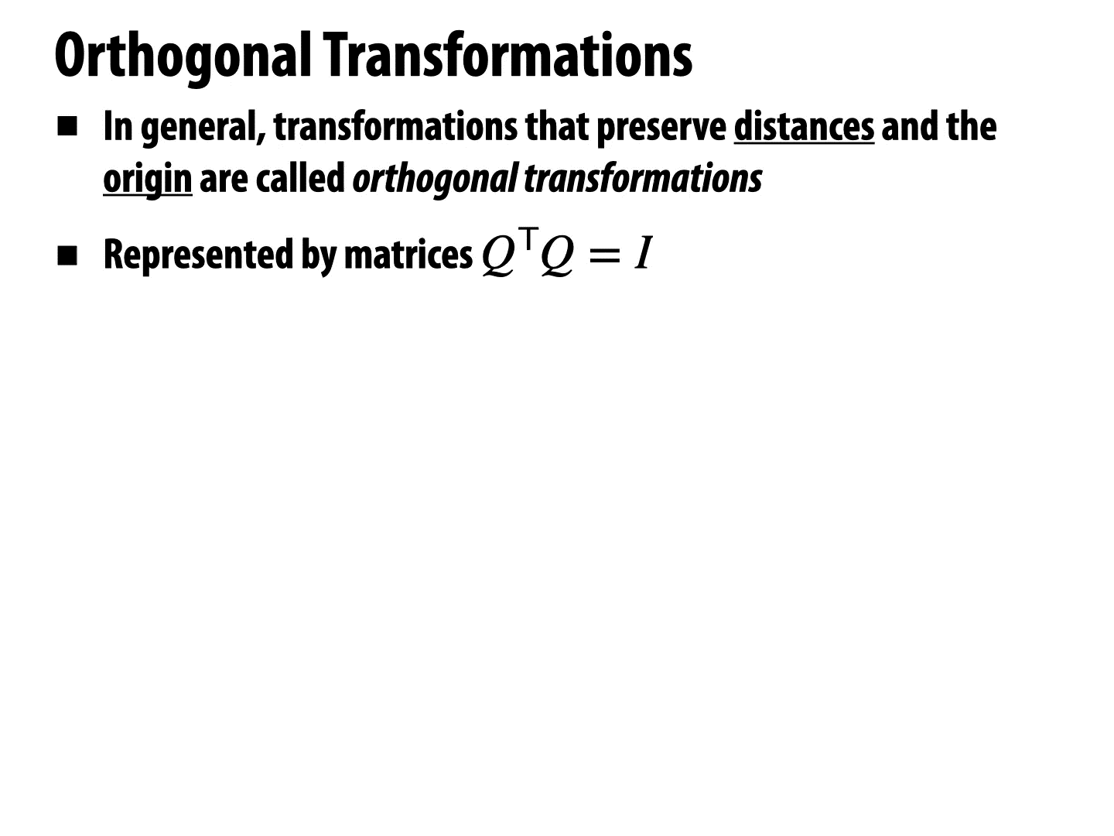
© Keenan Crane

Slide 25
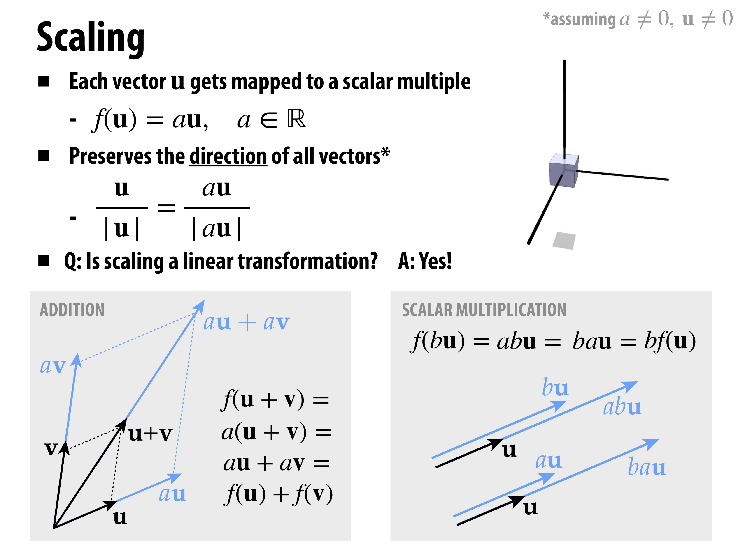
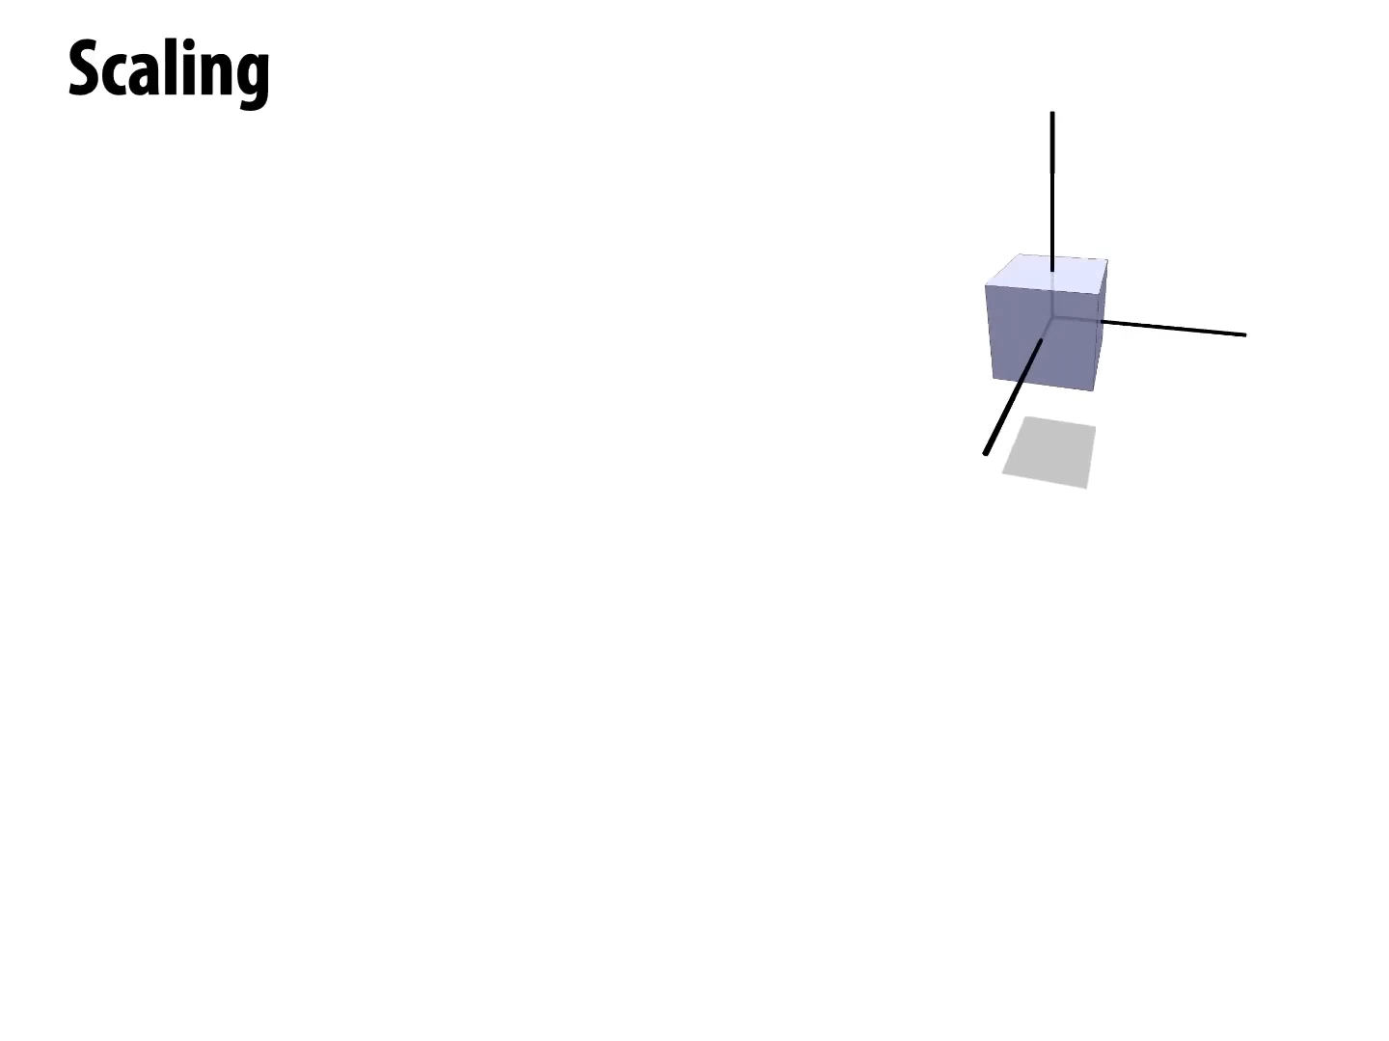
© Keenan Crane

Slide 26
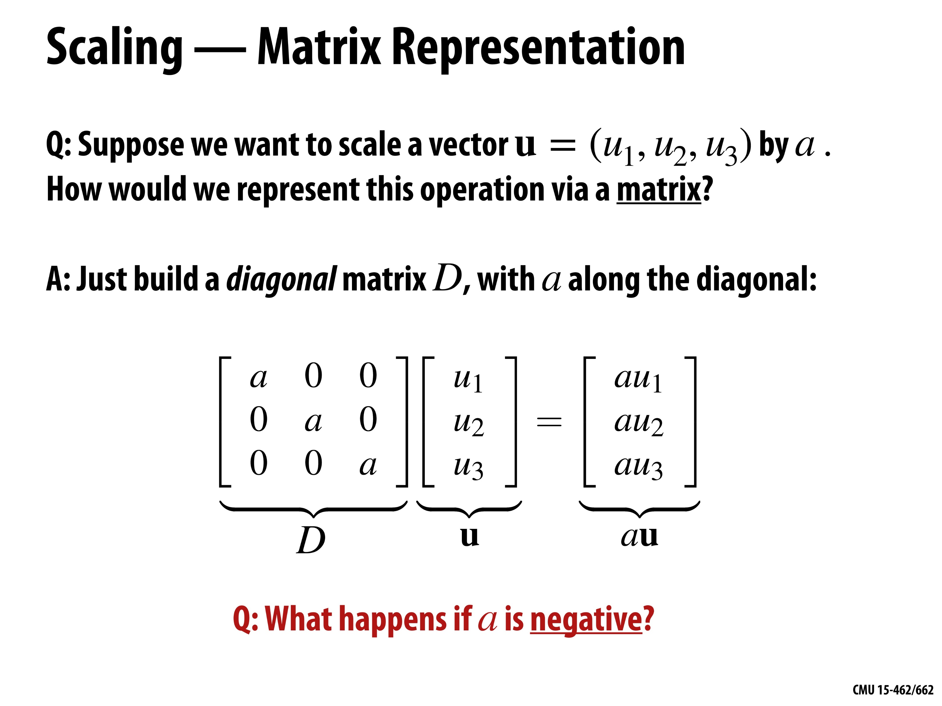
© Keenan Crane

Slide 27
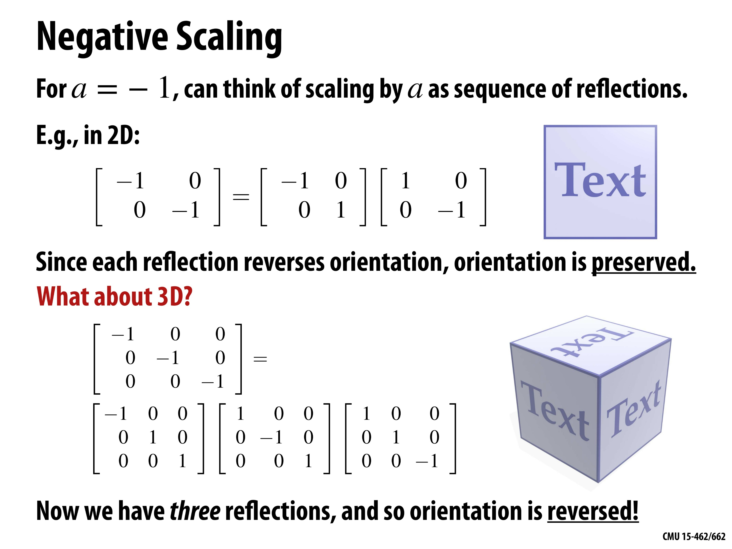
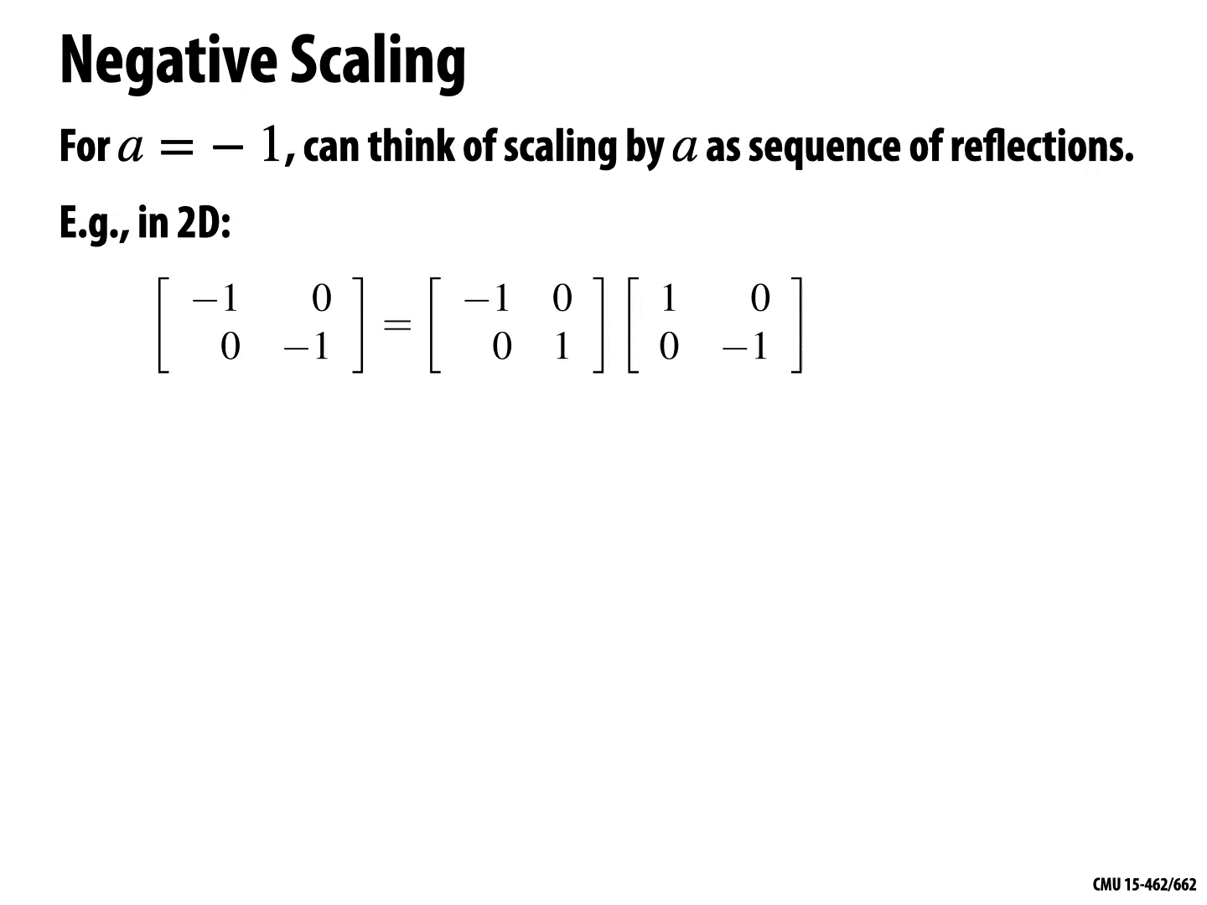
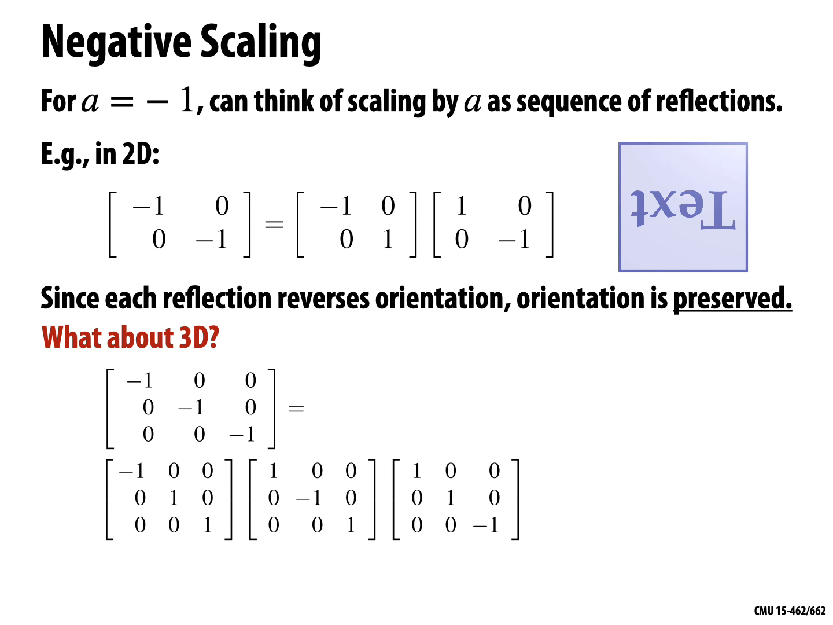
© Keenan Crane

Slide 28
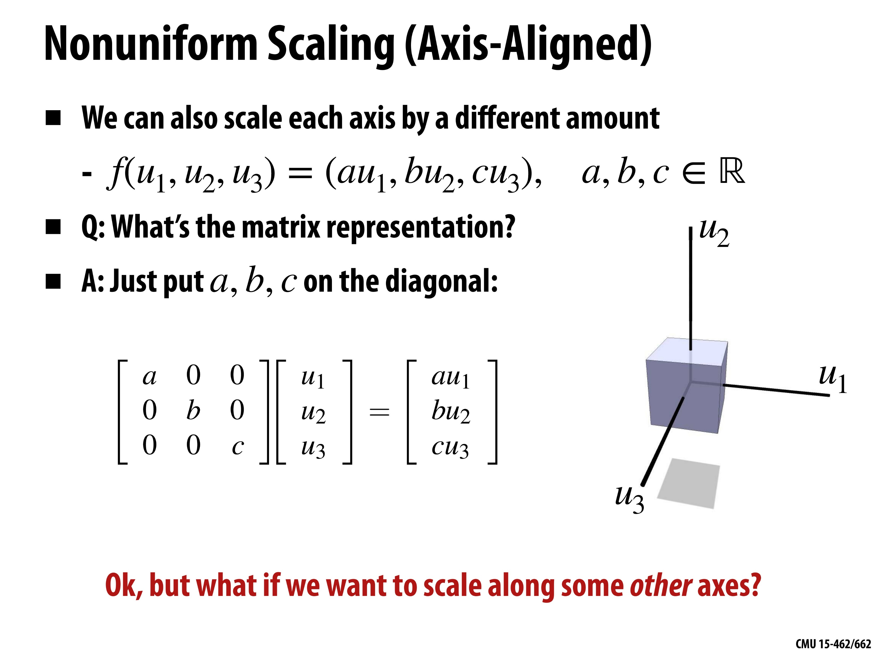
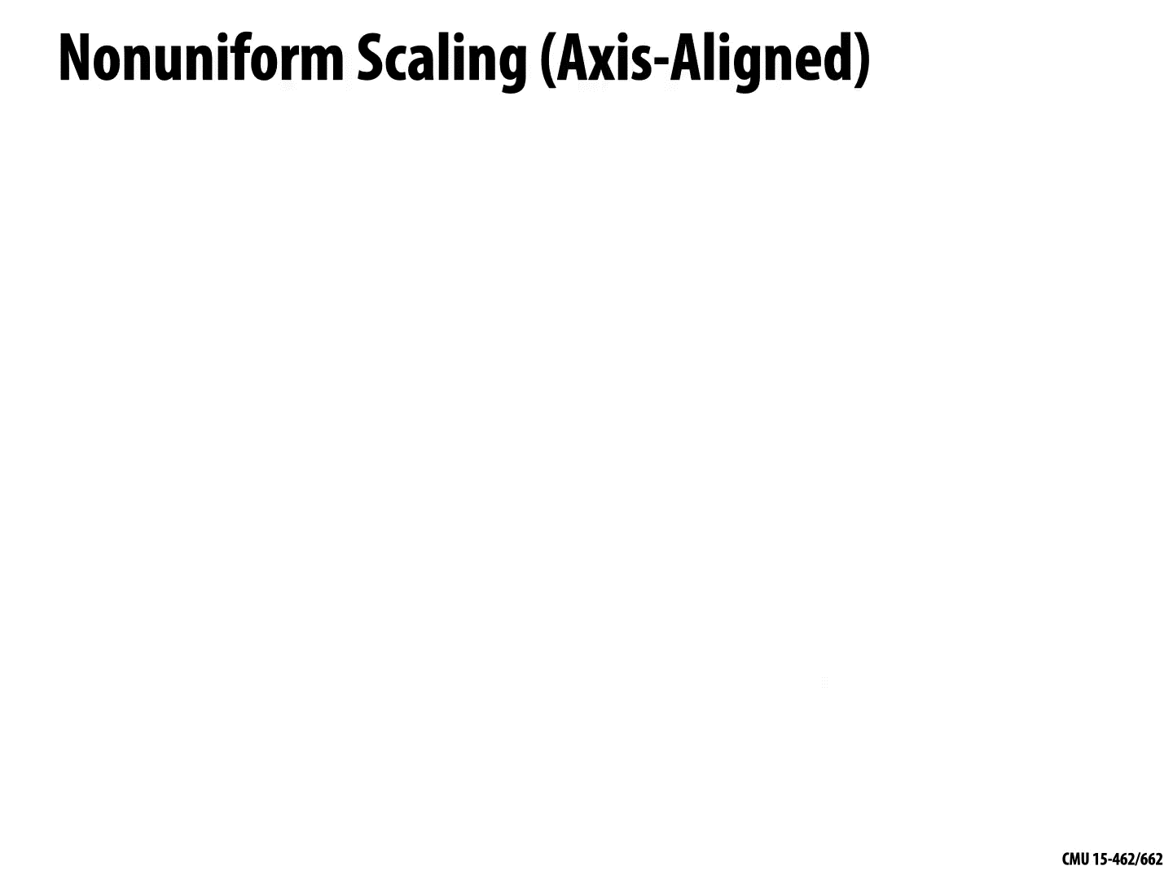
© Keenan Crane

Slide 29
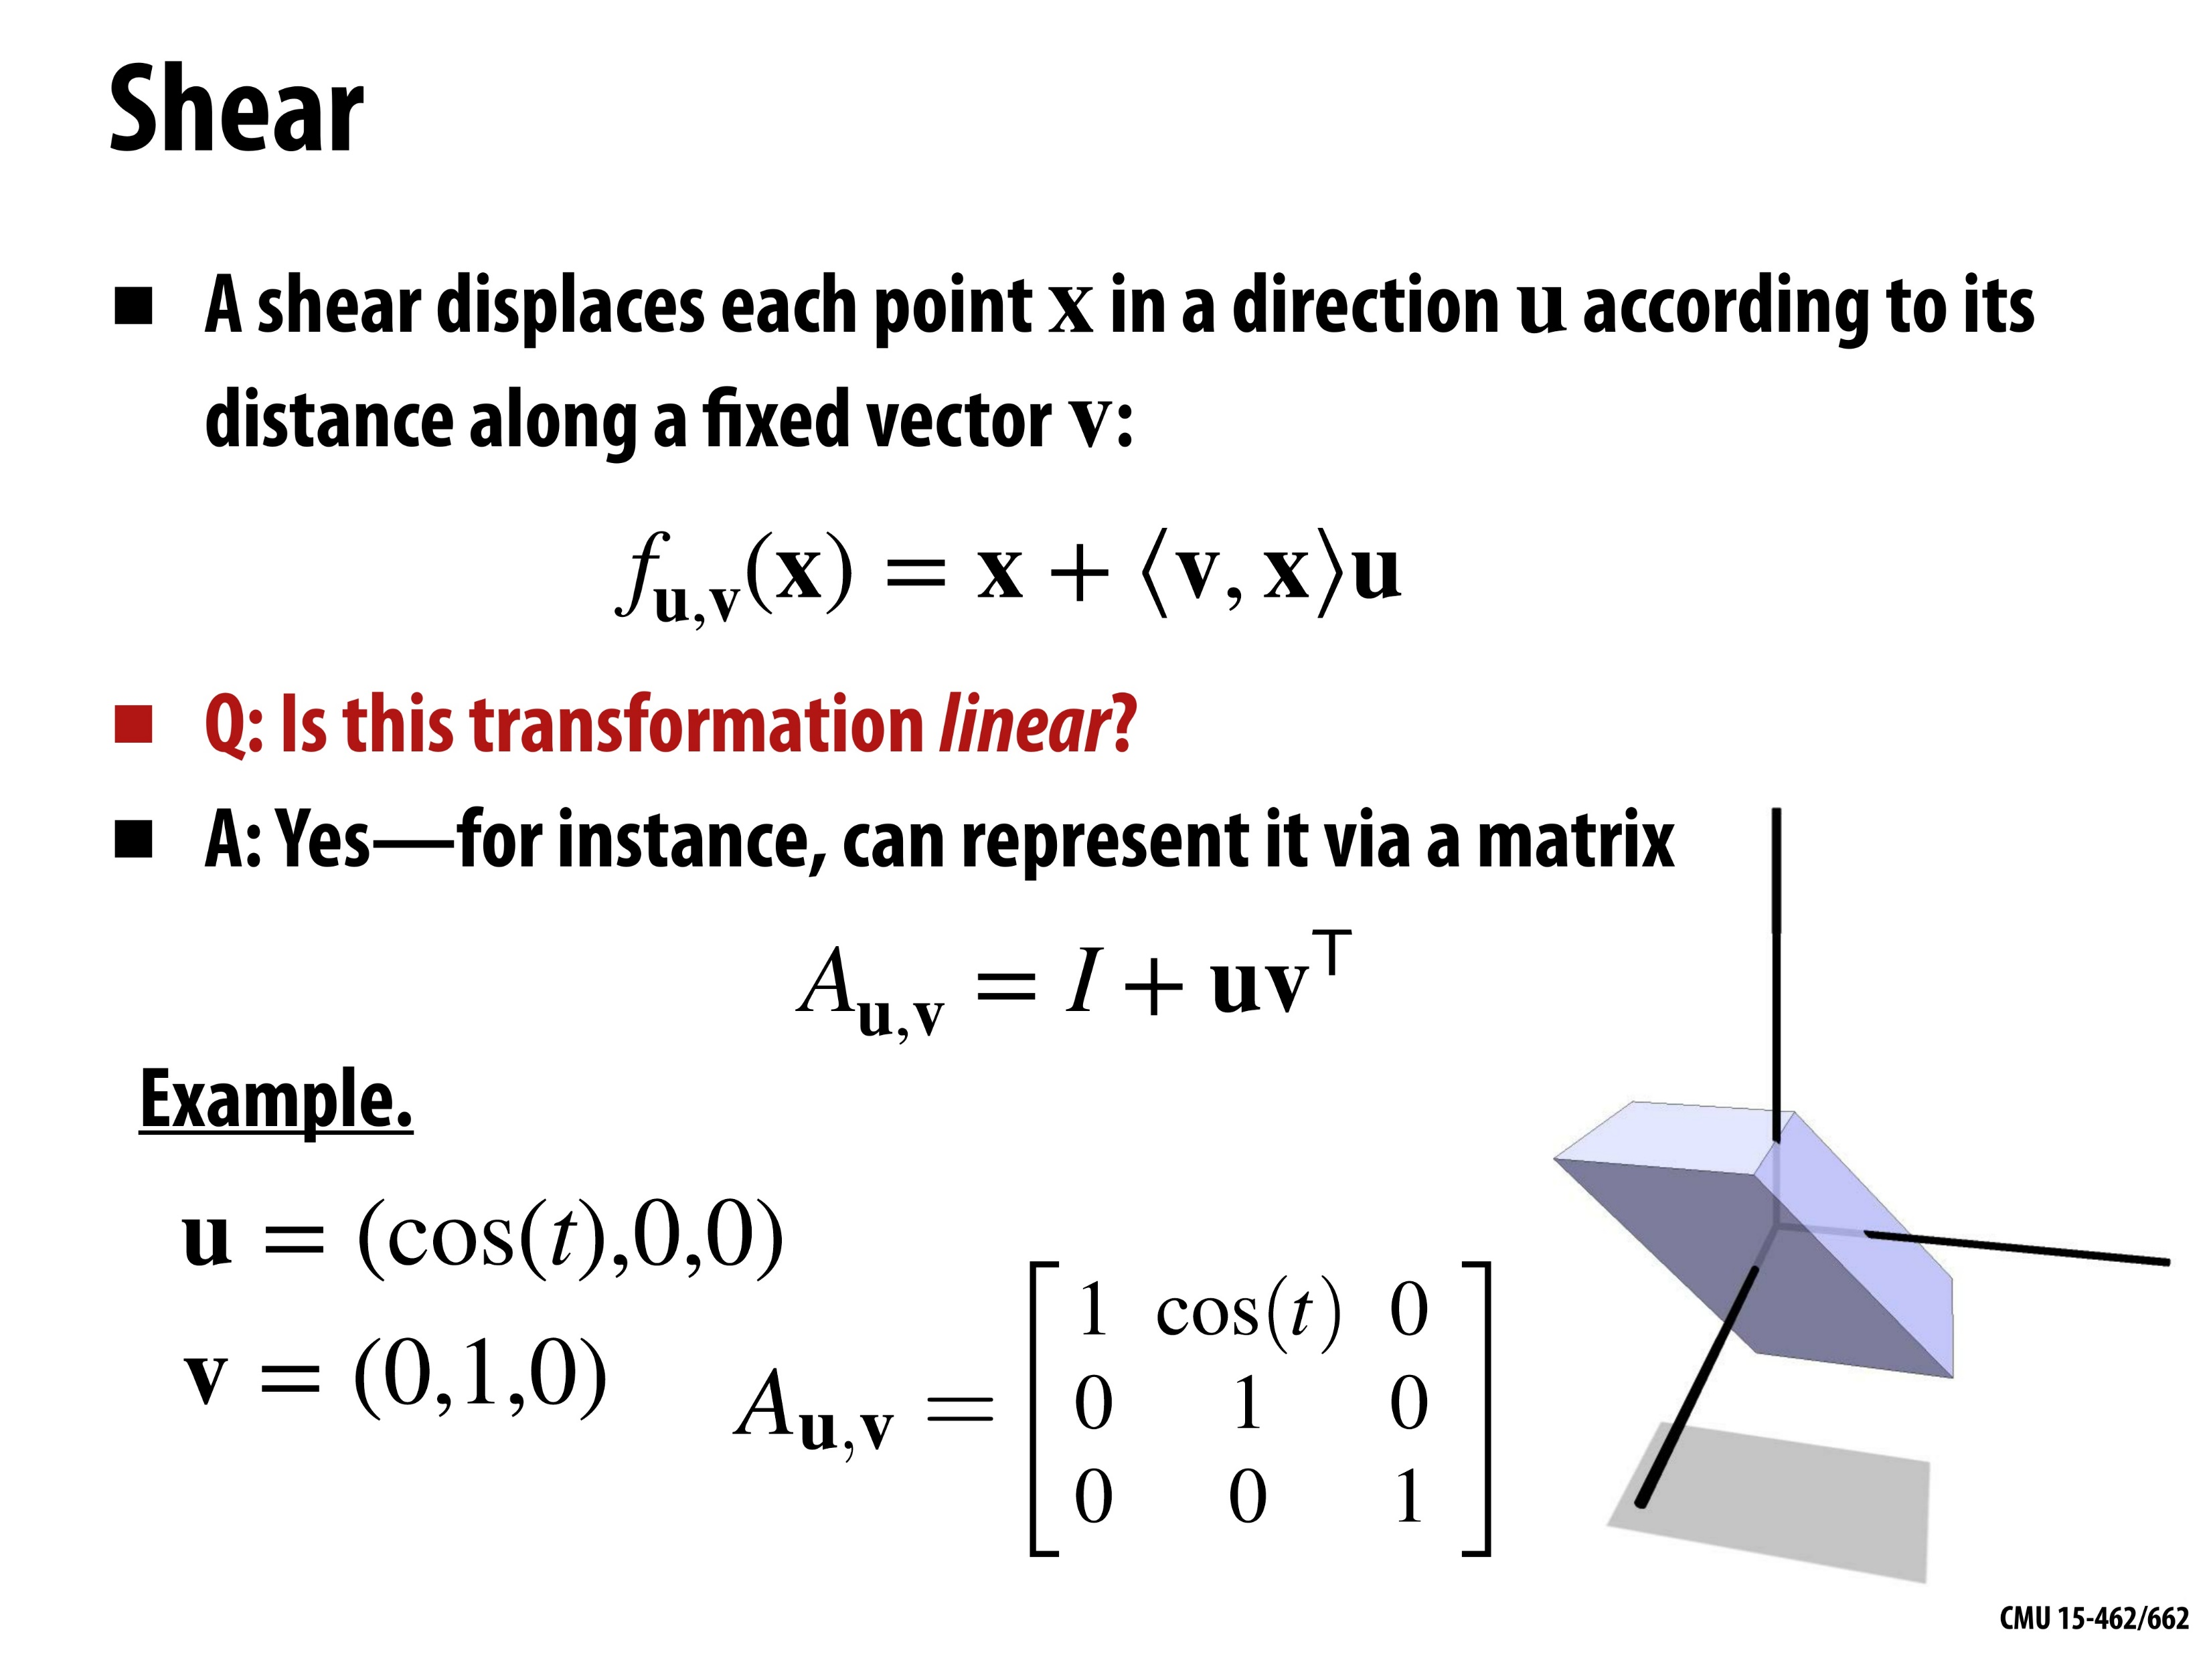
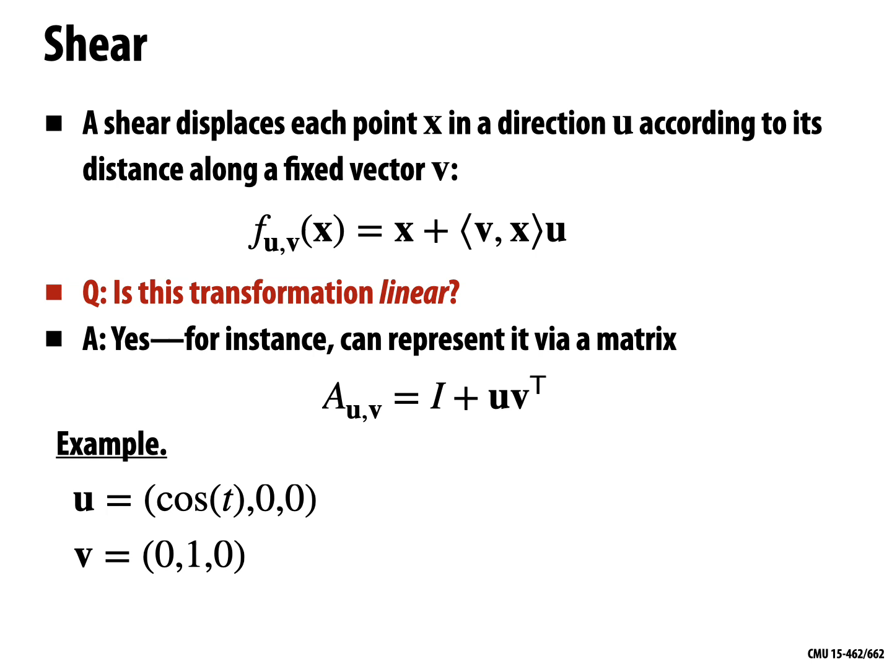
© Keenan Crane

Slide 30
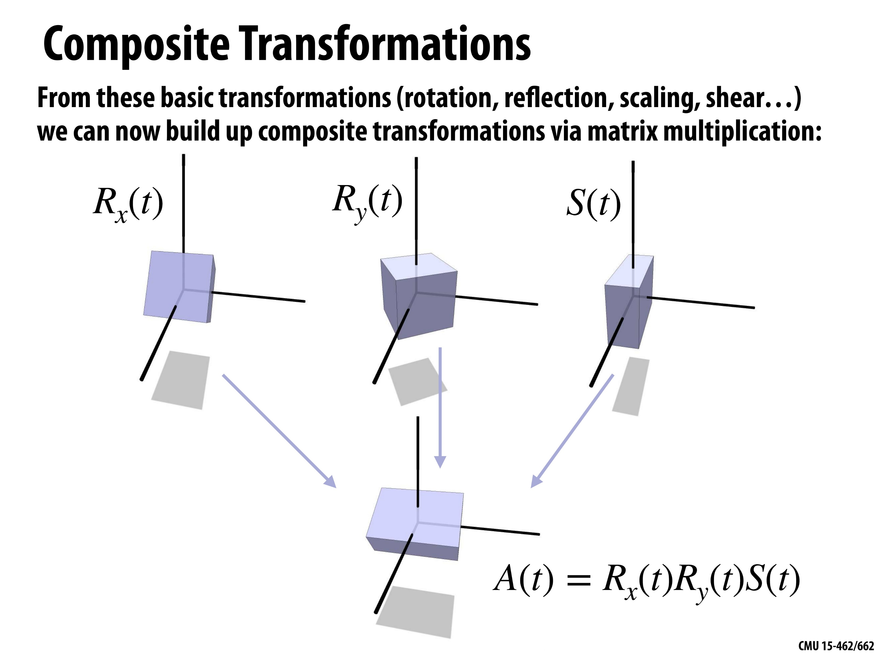
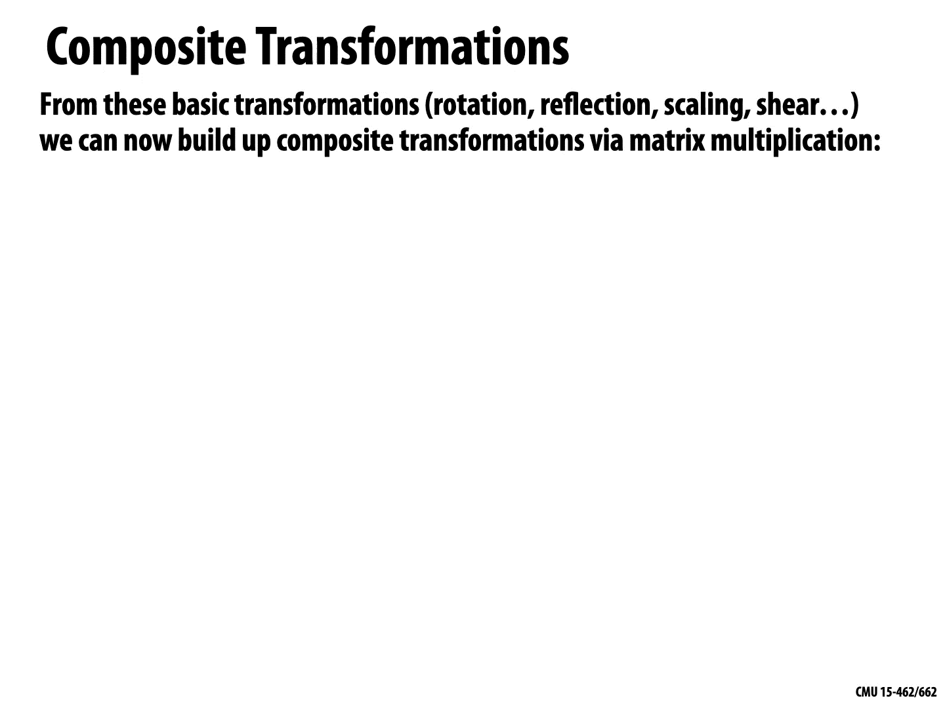
© Keenan Crane

Slide 31
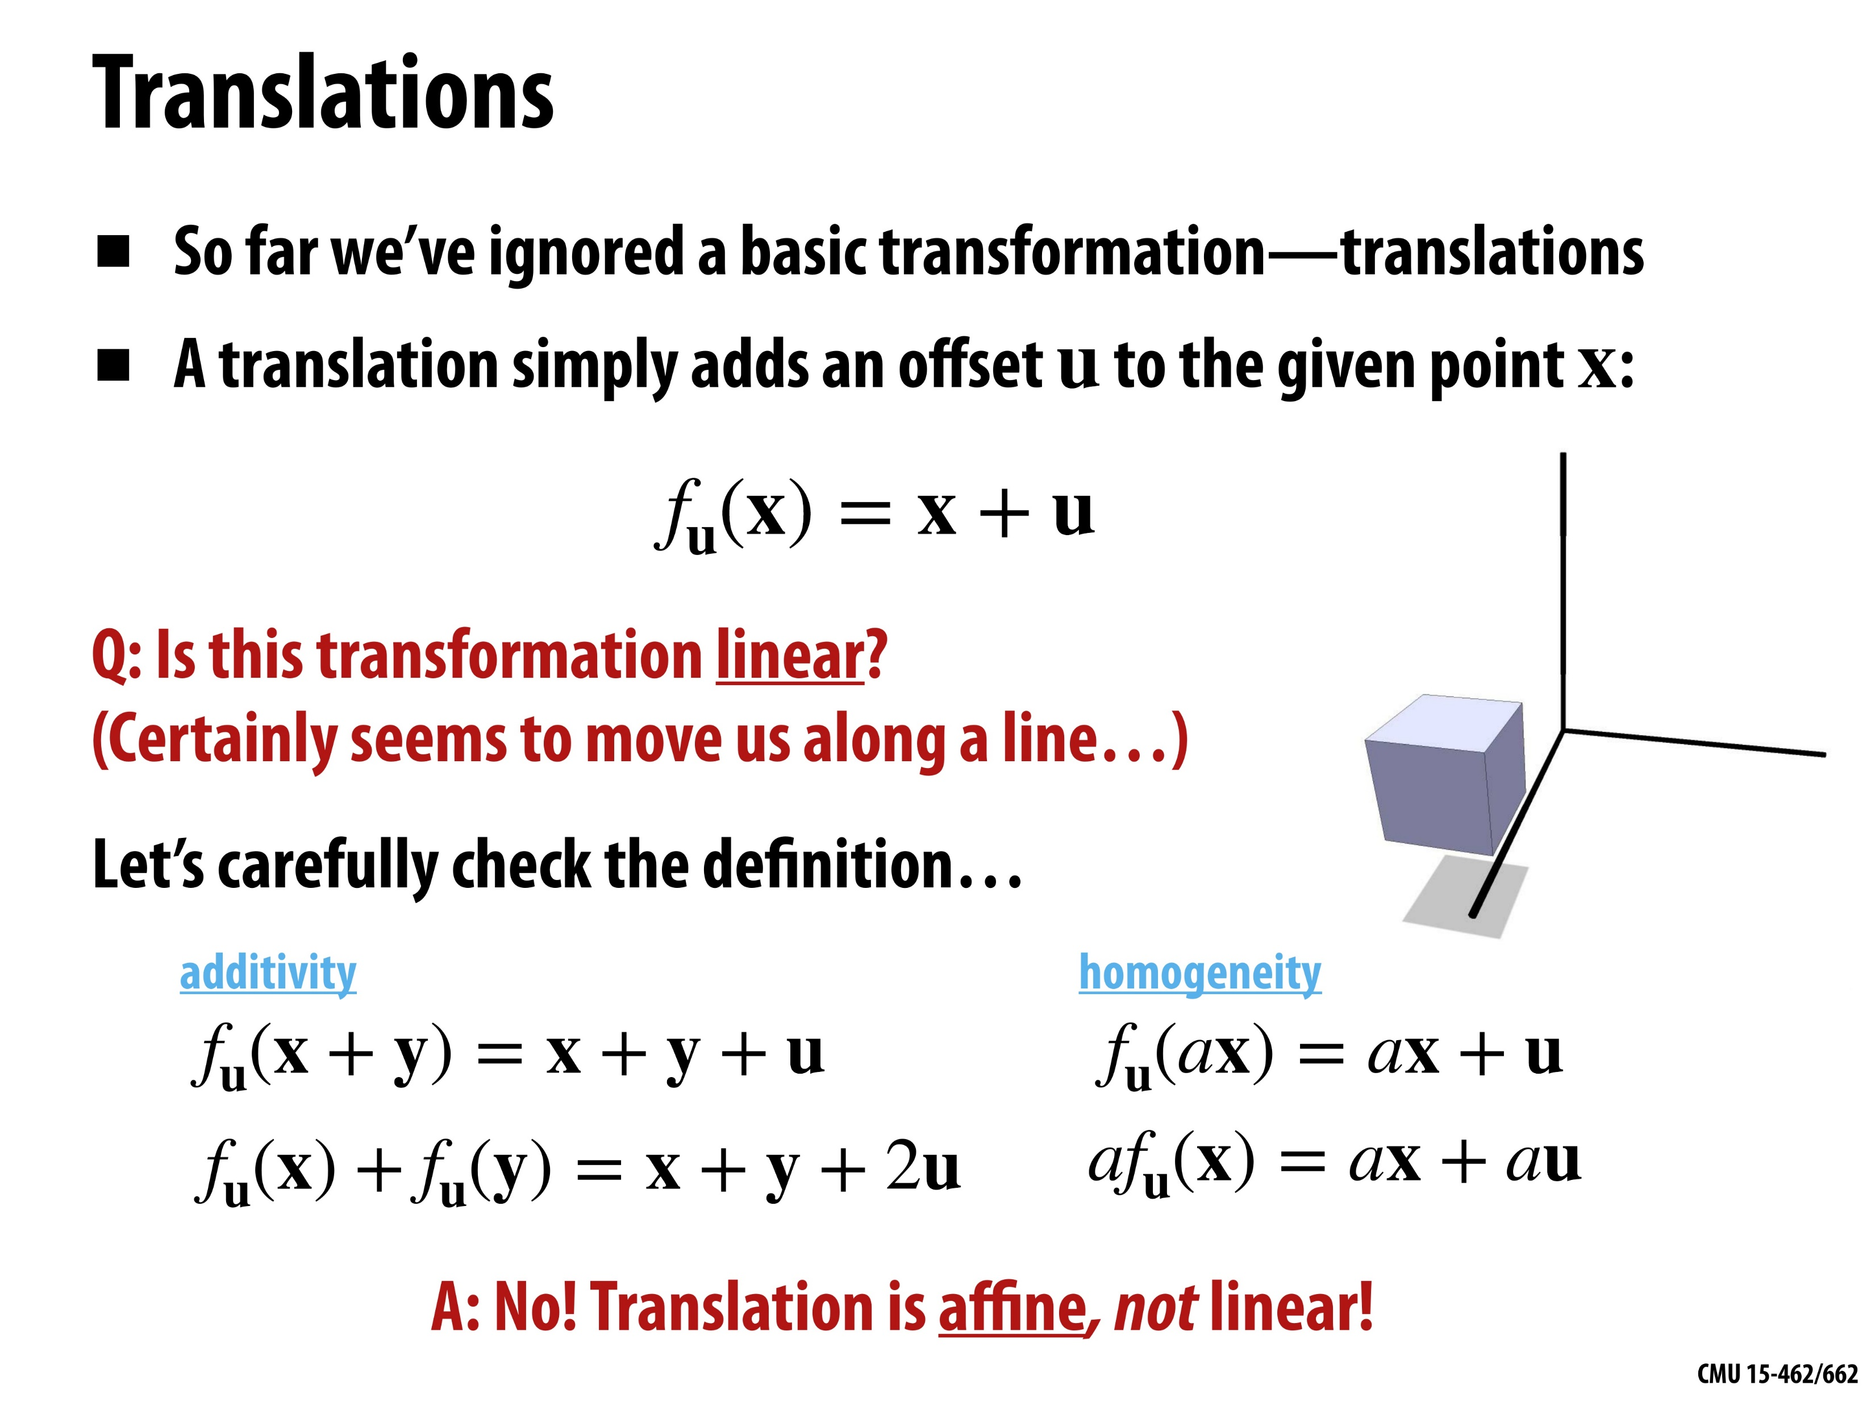
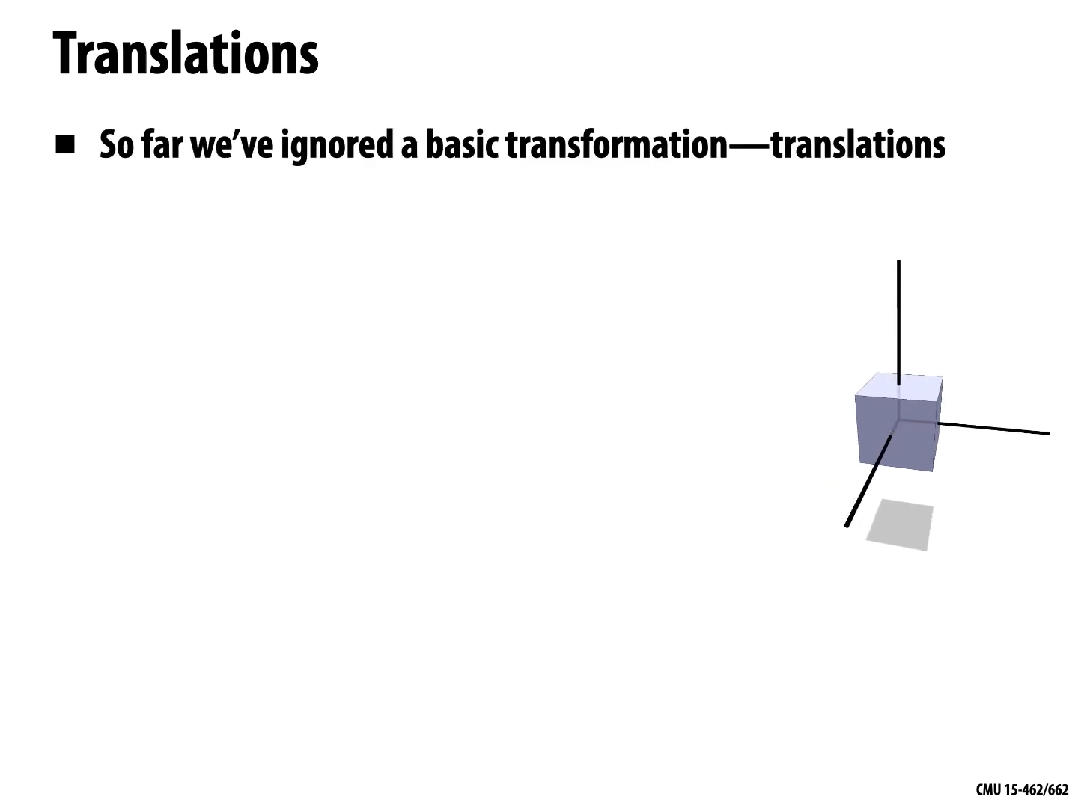
© Keenan Crane

Slide 32
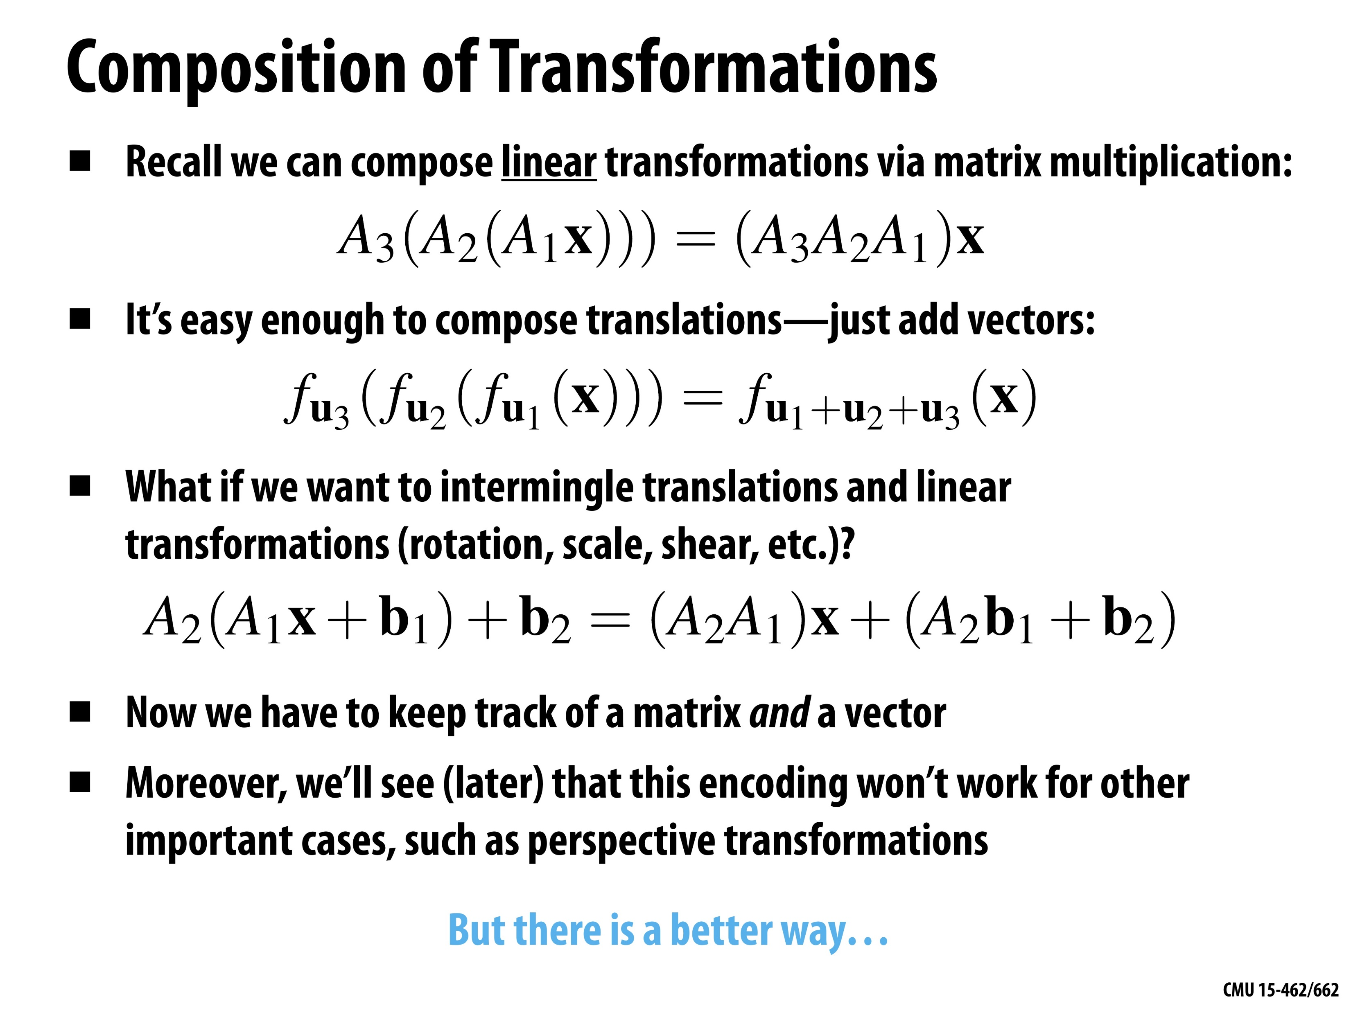
© Keenan Crane

Slide 33
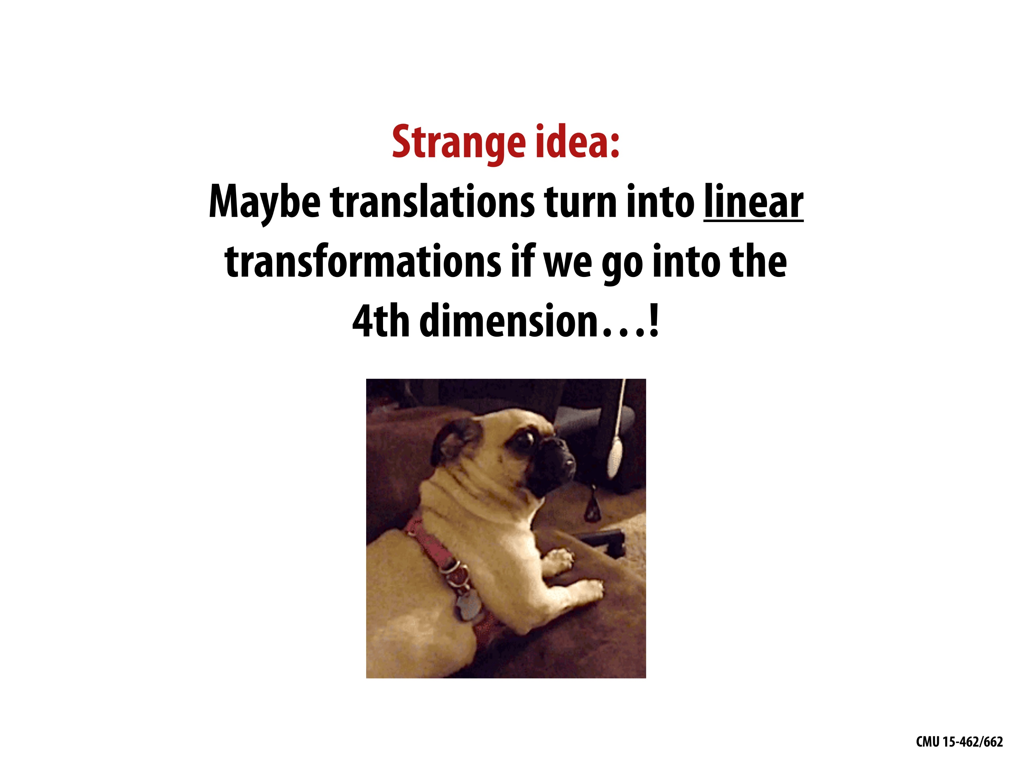
© Keenan Crane

Slide 34
3D Sensor Data Processing (2023)
Homogeneous Coordinates

Slide 35
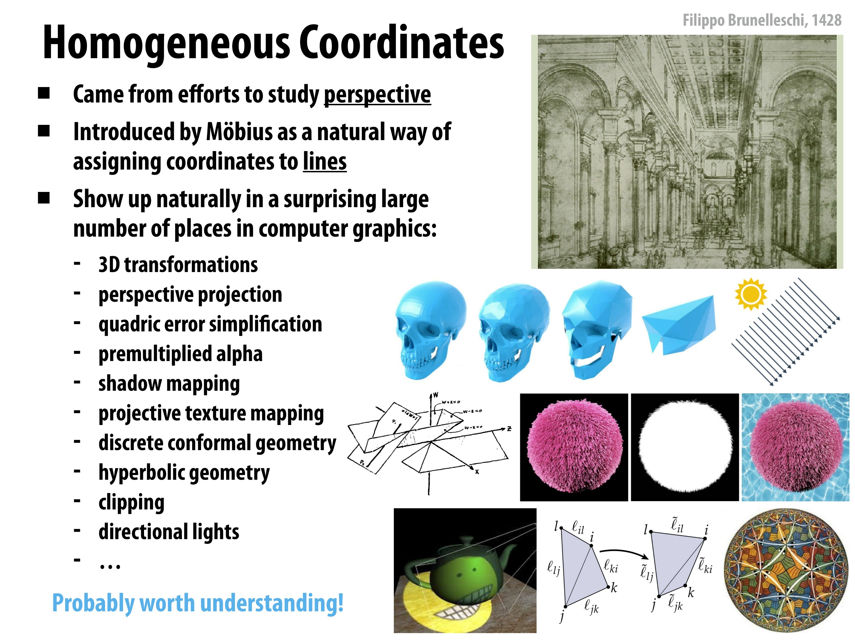
© Keenan Crane

Slide 36
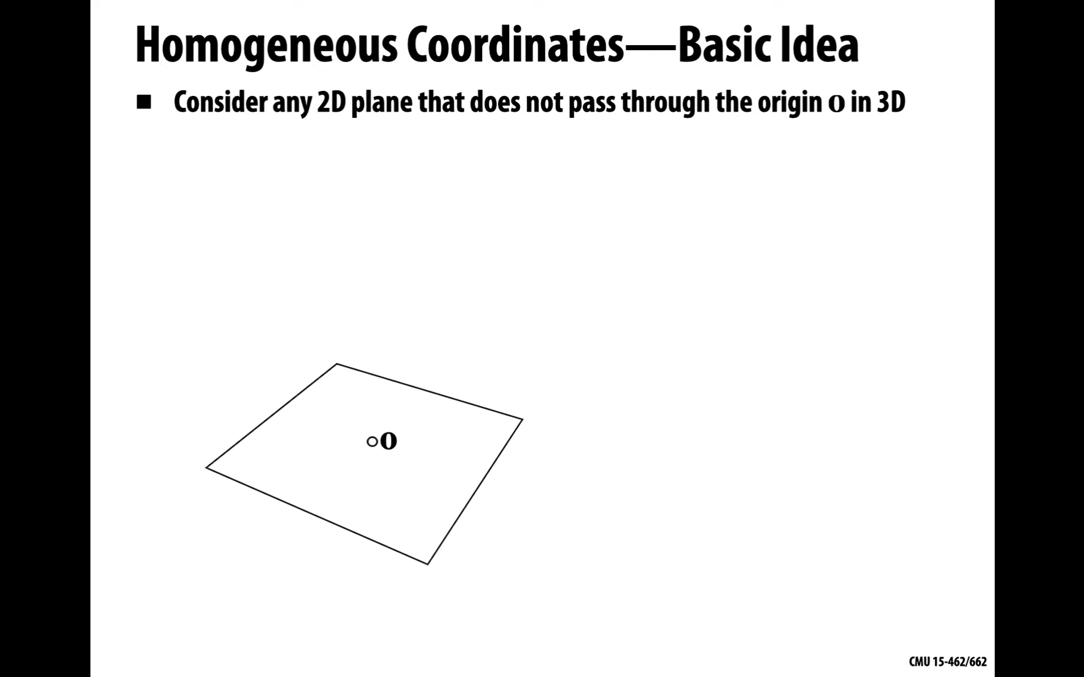
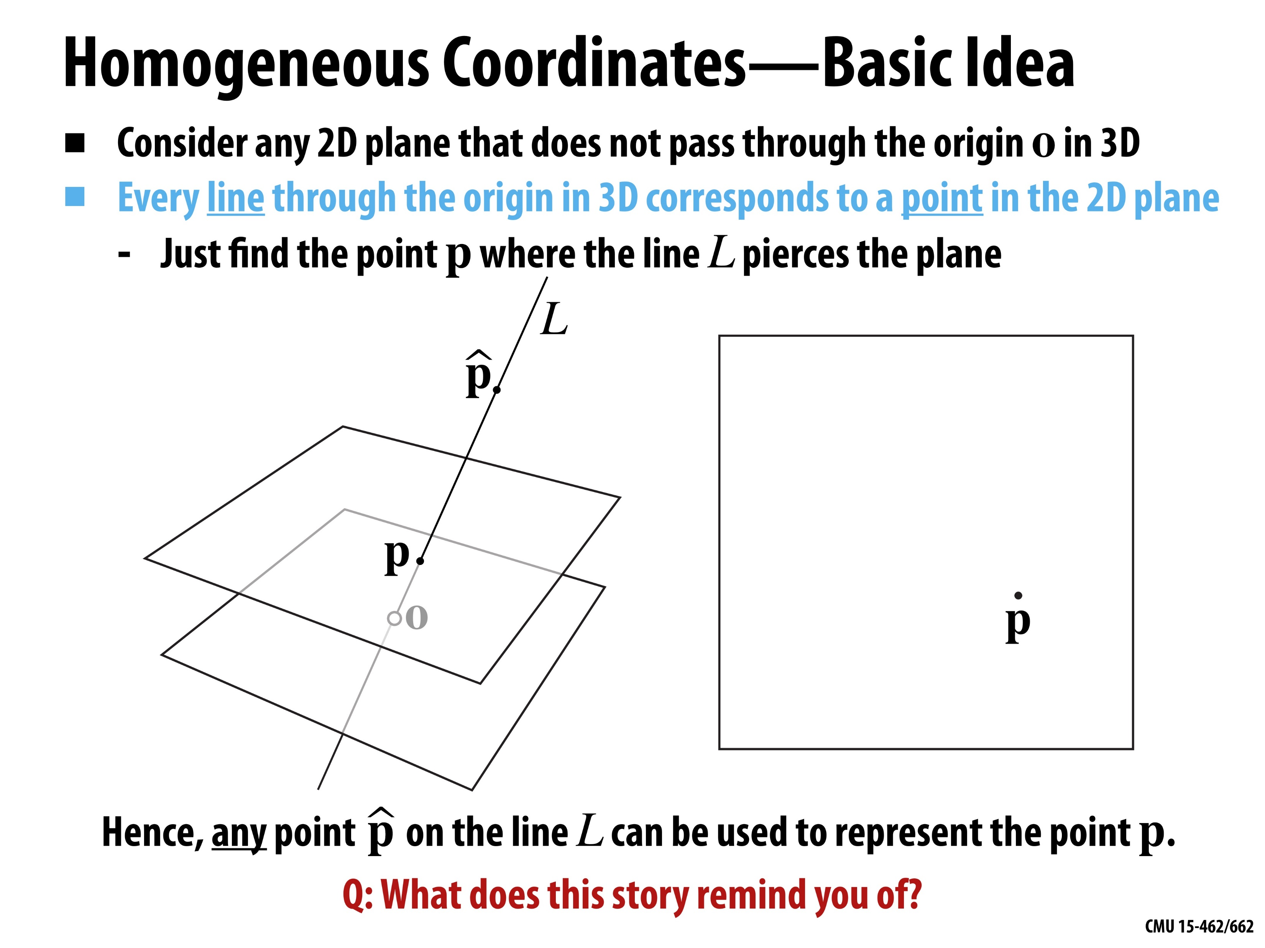
© Keenan Crane

Slide 37
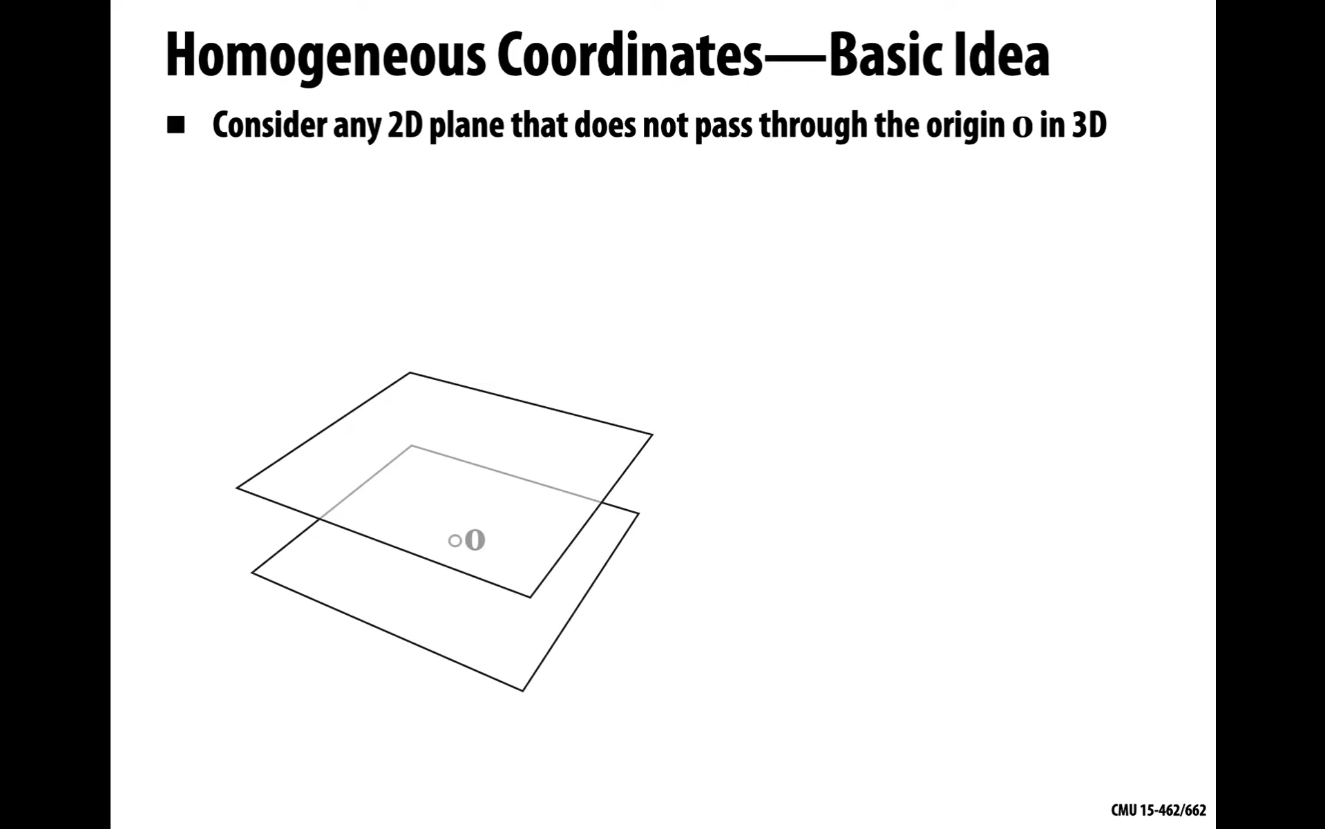
© Keenan Crane

Slide 38
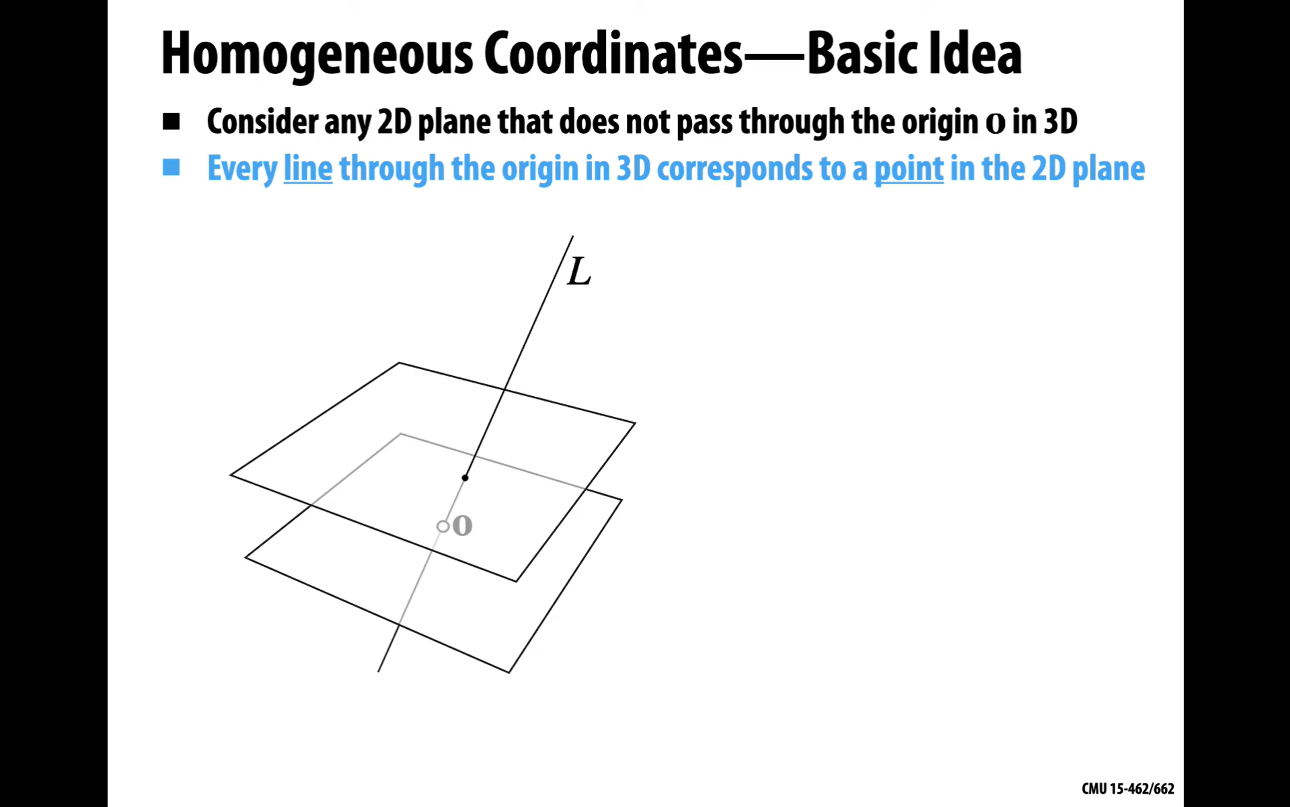
© Keenan Crane

Slide 39
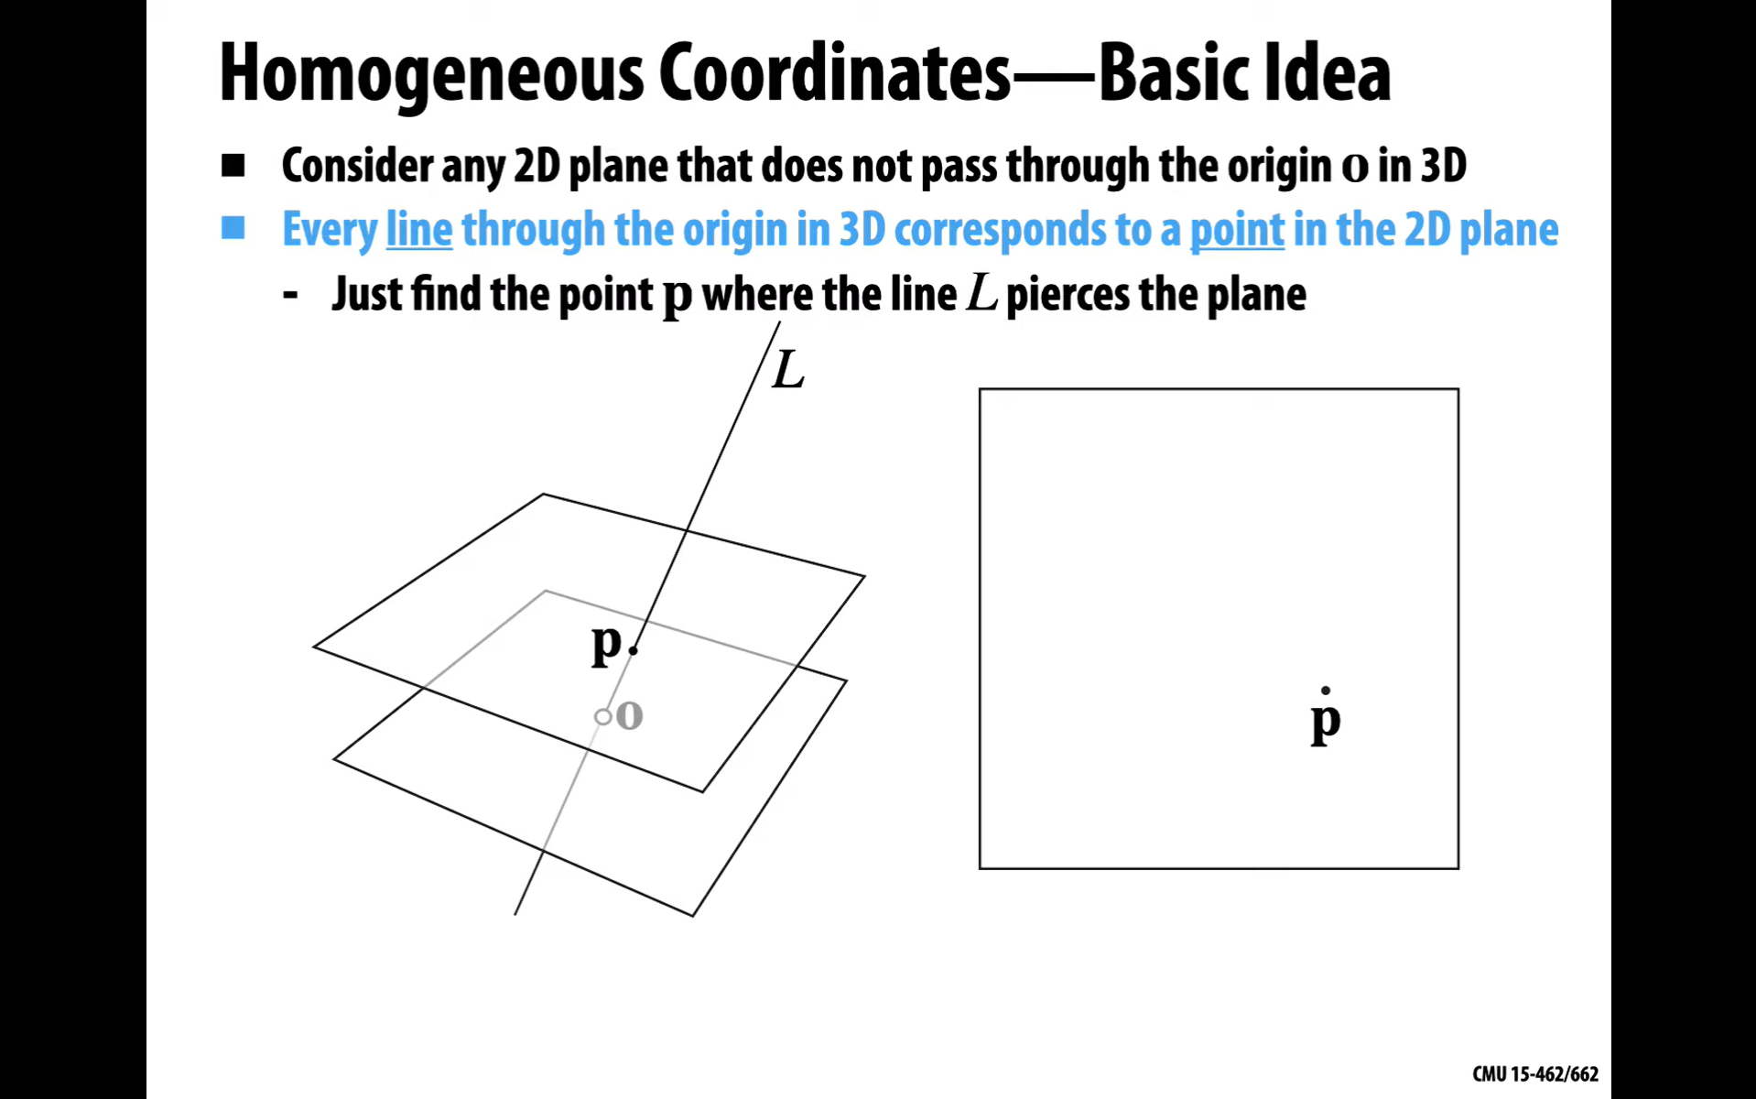
© Keenan Crane

Slide 40
© Keenan Crane

Slide 41
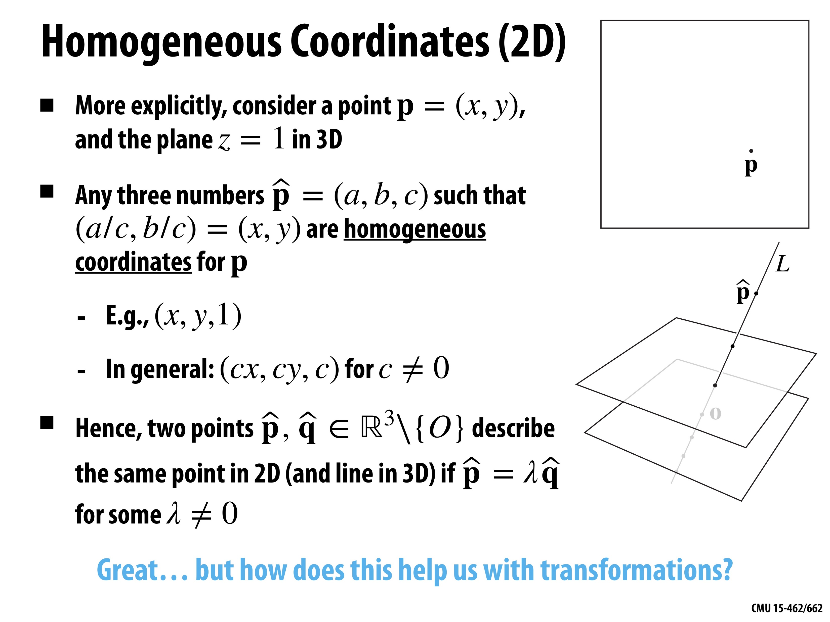
© Keenan Crane

Slide 42
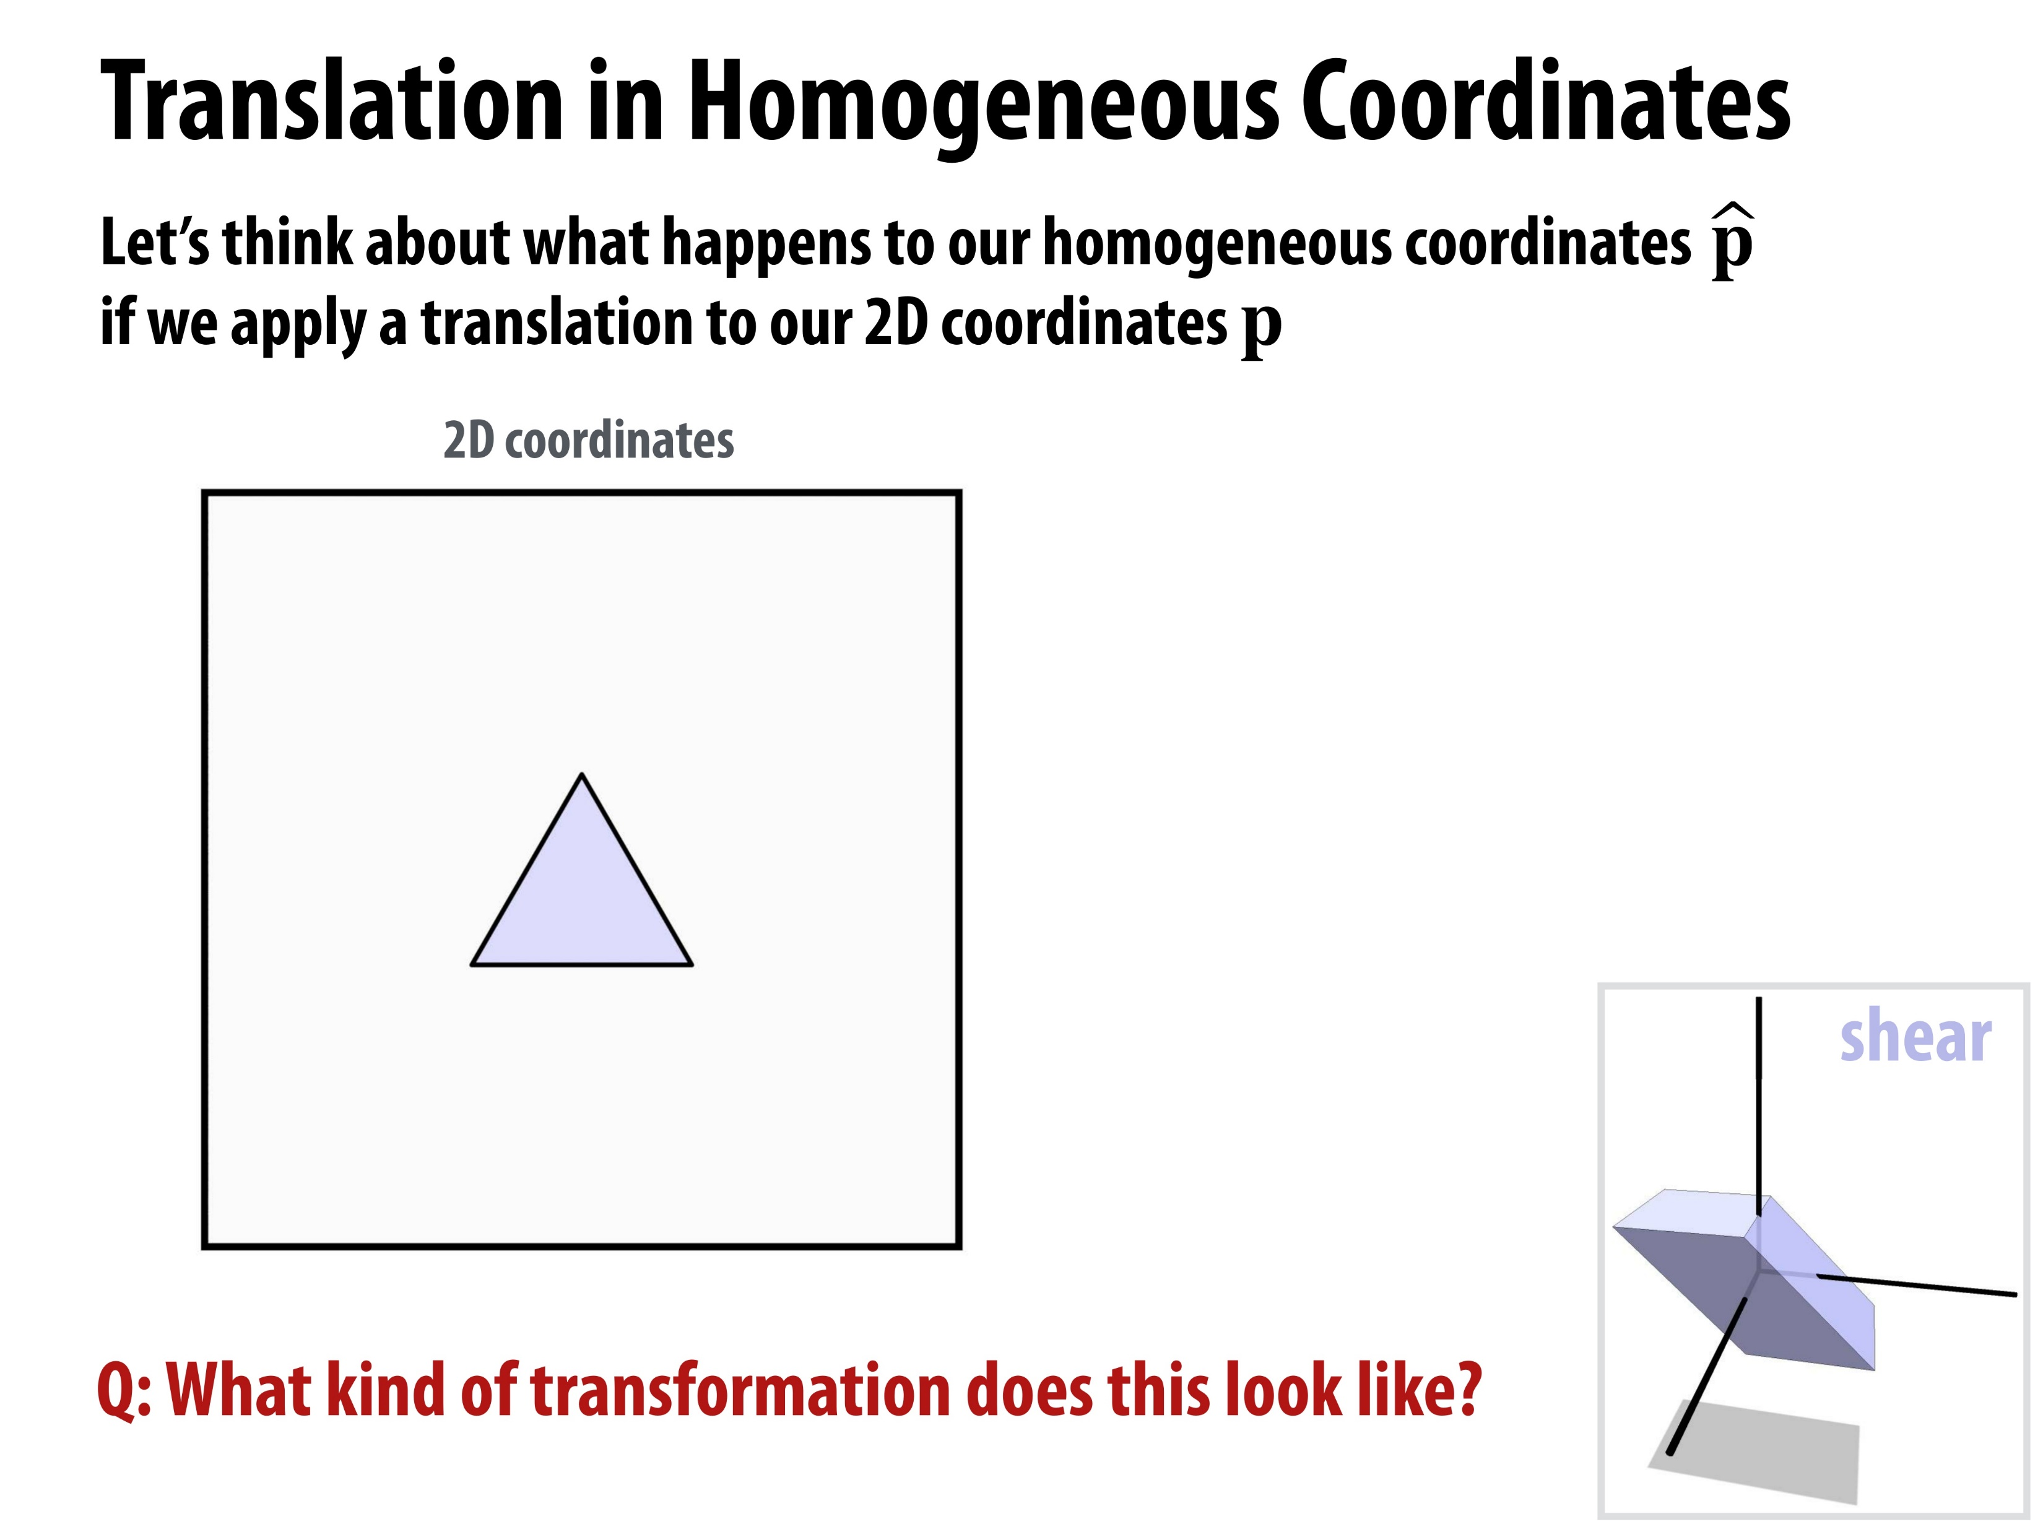

© Keenan Crane

Slide 43

© Keenan Crane

Slide 44

© Keenan Crane

Slide 45

© Keenan Crane

Slide 46

© Keenan Crane

Slide 47

© Keenan Crane

Slide 48

© Keenan Crane

Slide 49

© Keenan Crane

Slide 50

© Keenan Crane

Slide 51

© Keenan Crane

Slide 52
© Keenan Crane

Slide 53

© Keenan Crane

Slide 54
3D Sensor Data Processing (2023)
Thank You
🗂️3D Sensor Data Processing Curriculum

Slide 55
3D Sensor Data Processing (2023)
Appendix

Slide 56

Title
Content
Content
Content
Content
Fig. / Video.
Caption & Ref. (Link)
[Ref] Shan Liu, Min Zhang, Pranav Kadam, C.-C. Jay Kuo - 3D Point Cloud Analysis_ Traditional, Deep Learning, and Explainable Machine Learning Methods-Springer (2021)

